Slide 1

Top 10 clinical tips

Slide 2
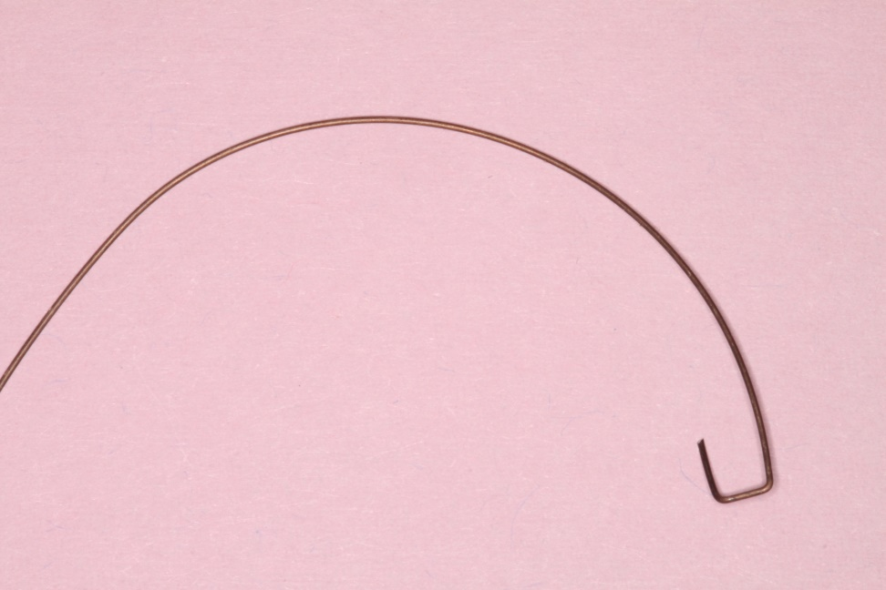

Single tooth torqueing auxiliary
0.014 Australian special plus

Slide 3
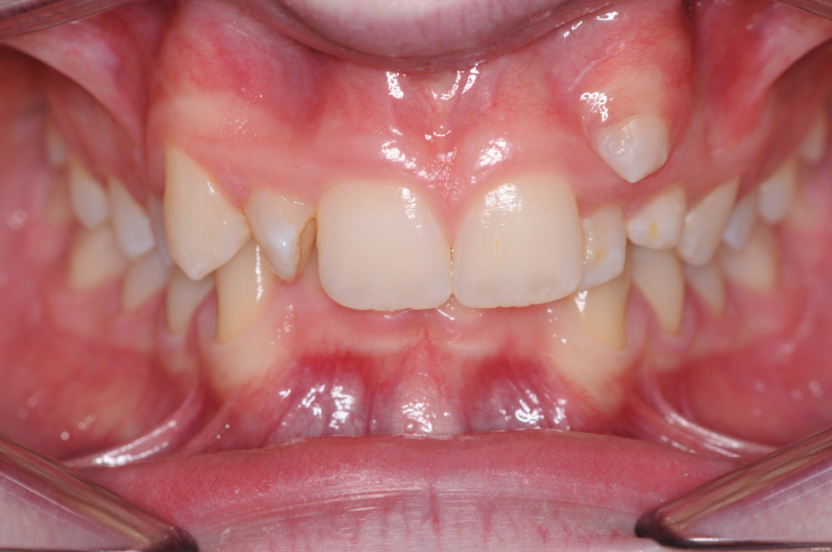
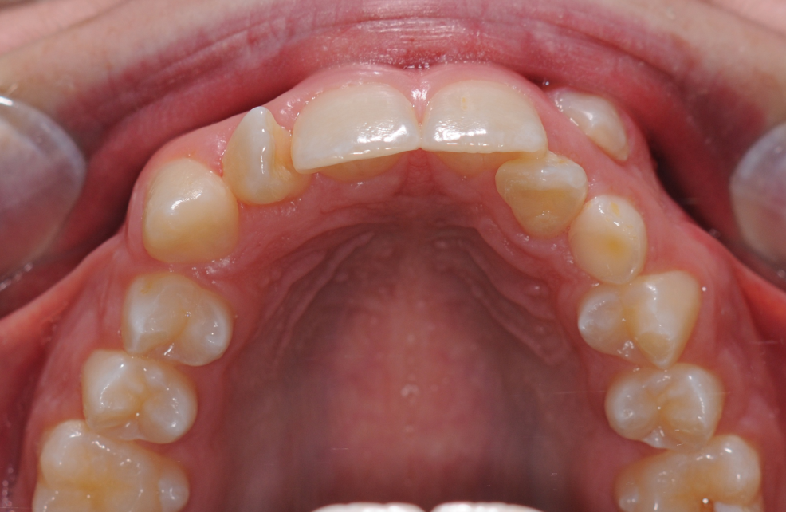
Instanding UL2

Slide 4
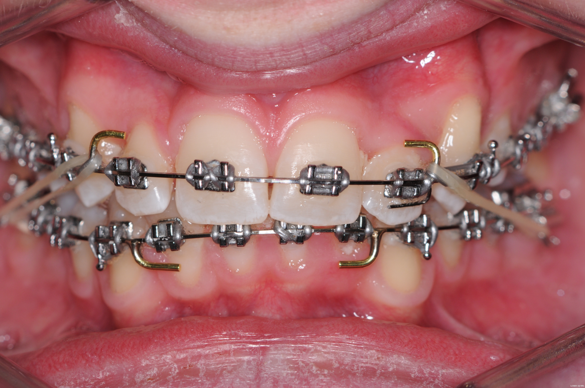
0.014 TA beneath posted arch-wire

Slide 5
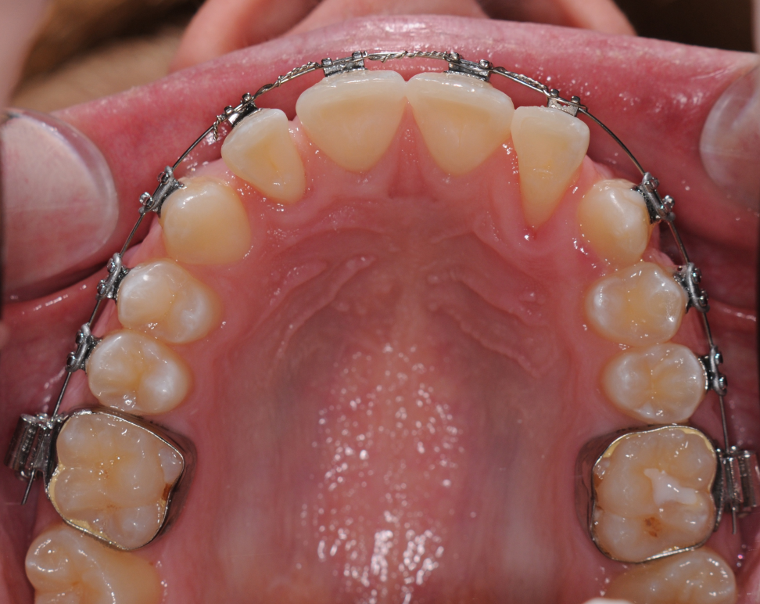
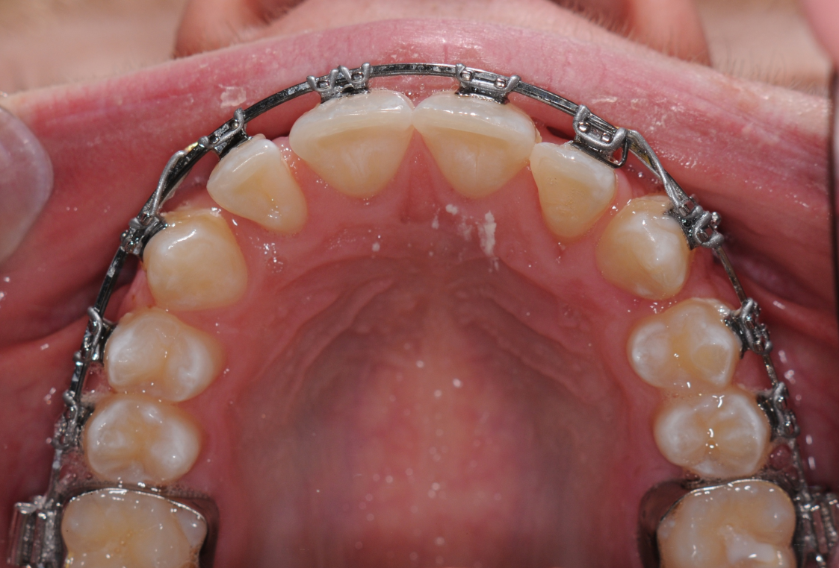
A simple piece of 014 Australian wire will provide torque in either direction. Because it works on any base archwires movement can start much earlier and is much quicker than using rectangular wire. You can tell when torque is adequate by looking at the palatal surface
Insert TA
After 12 weeks

Slide 6
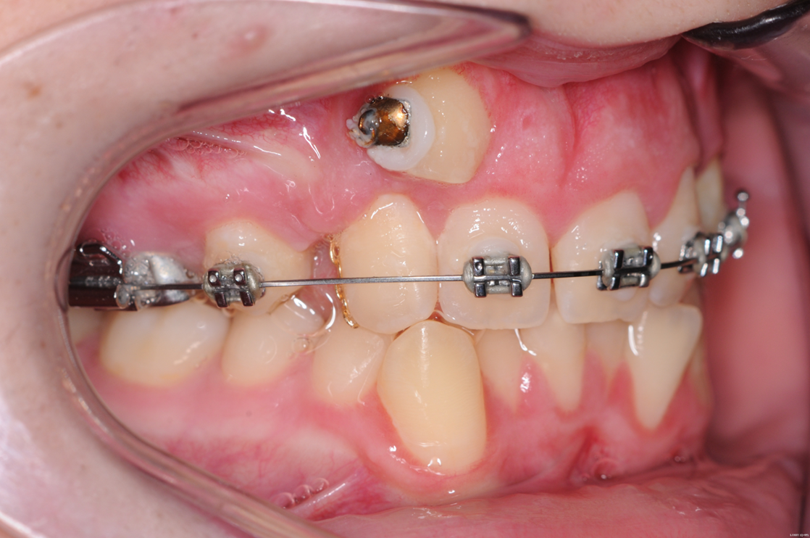
As seen on first visit with me. UR4 has been removed to let the canine down. When it failed to erupt a request for a closed exposure was made but the canine broke through the flap above the attached gingivae mesial to the upper lateral.

Slide 7
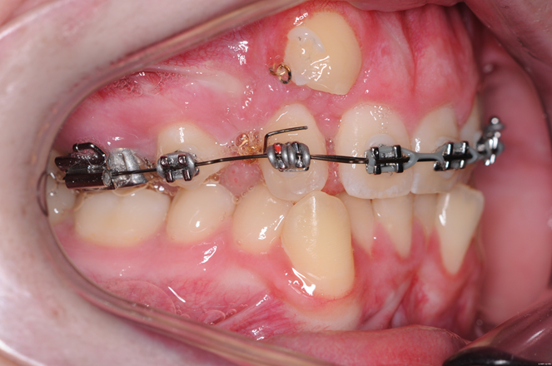
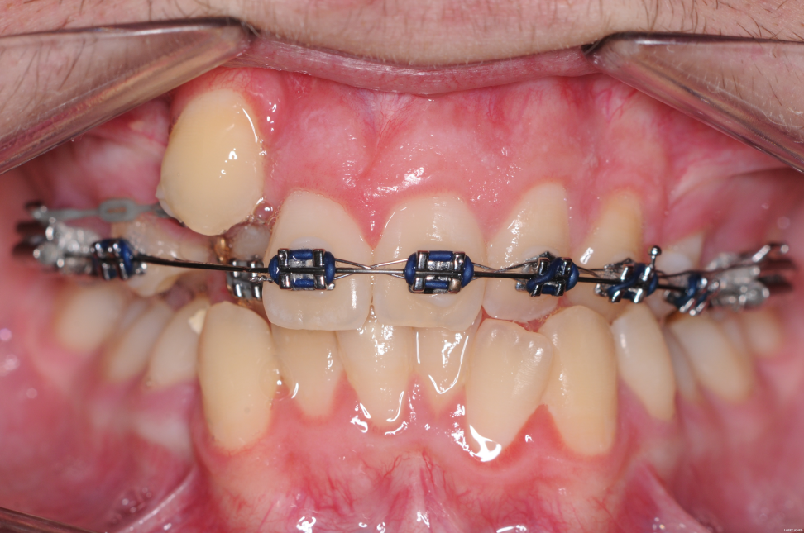
A single tooth torquing auxiliary was used to move the root of the lateral into the palate. Then the lateral and canine could be slid past each other

Slide 8
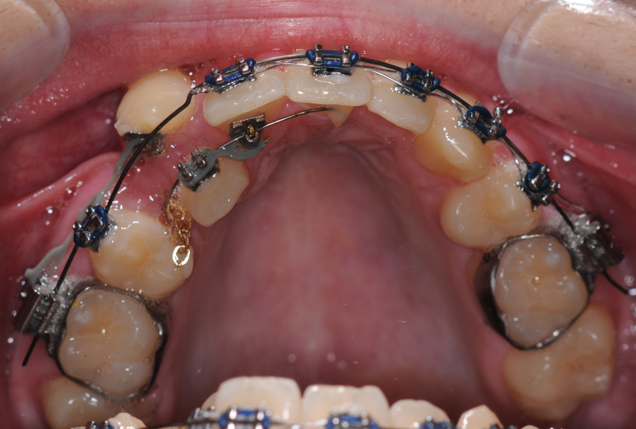
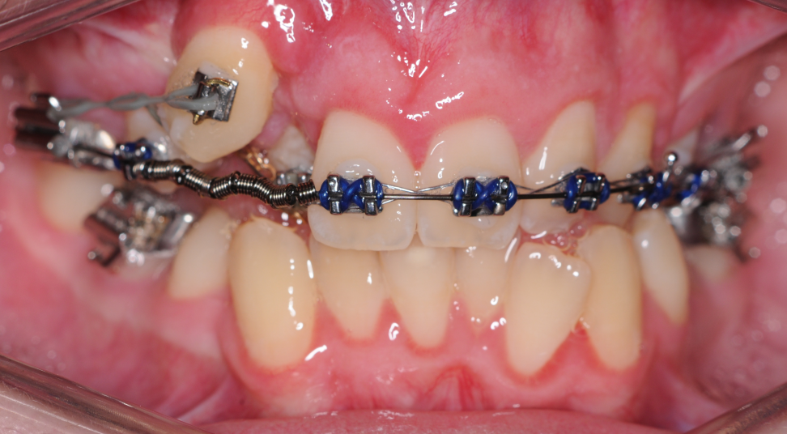
A dual track system used to slide the teeth

Slide 9
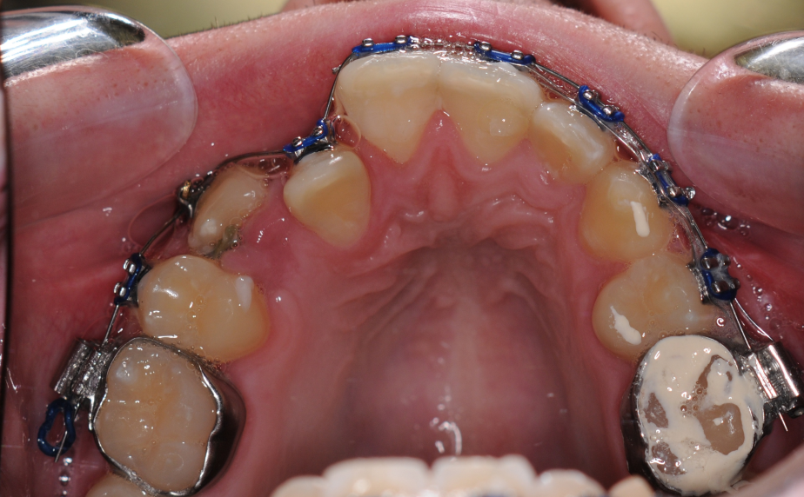
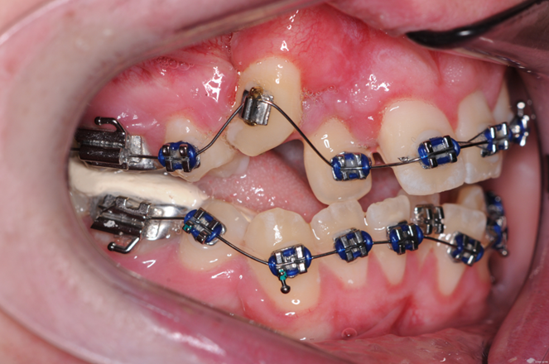
Using cement to free the bite the lateral incisor was moved over the bite

Slide 10
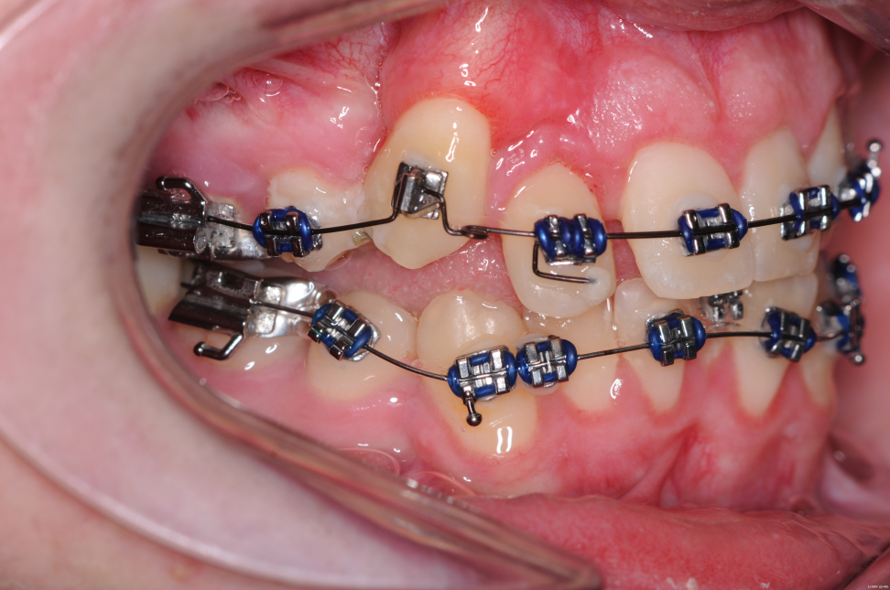
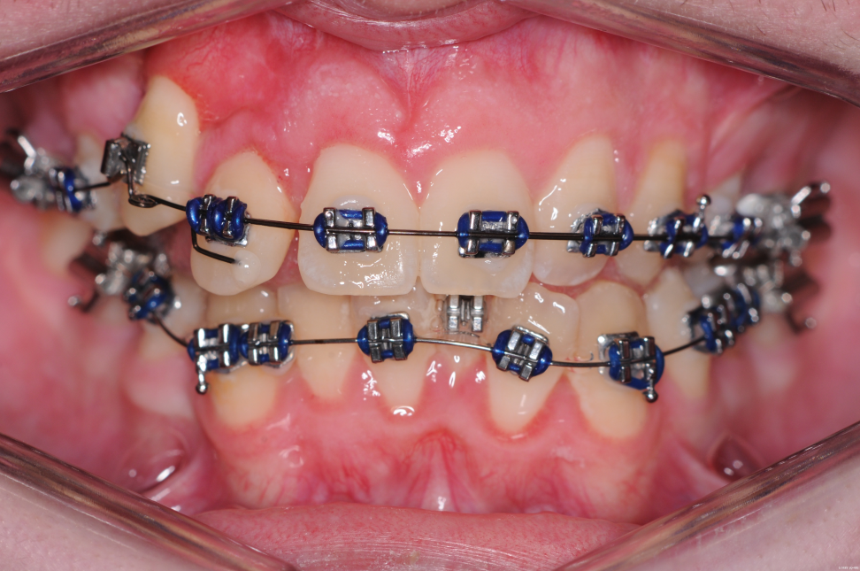
Now a single tooth torquing auxiliary can be used to move the root back out

Slide 11
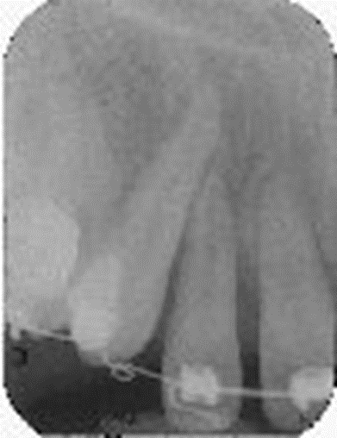
No root damage has occurred

Slide 12
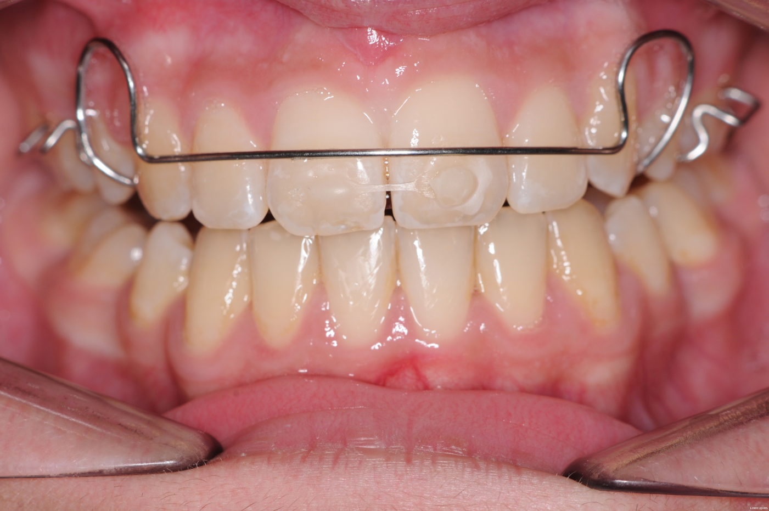

Closing diastema (Helen Taylor)
Helen Taylor’s useful idea when a diastema relapses. Fit a Hawley retainer, then bond elastic chain to the labial of 1/1. The Hawley must be worn at least 12 hours each day. After a week the diastema is closed. Place a PBR

Slide 13

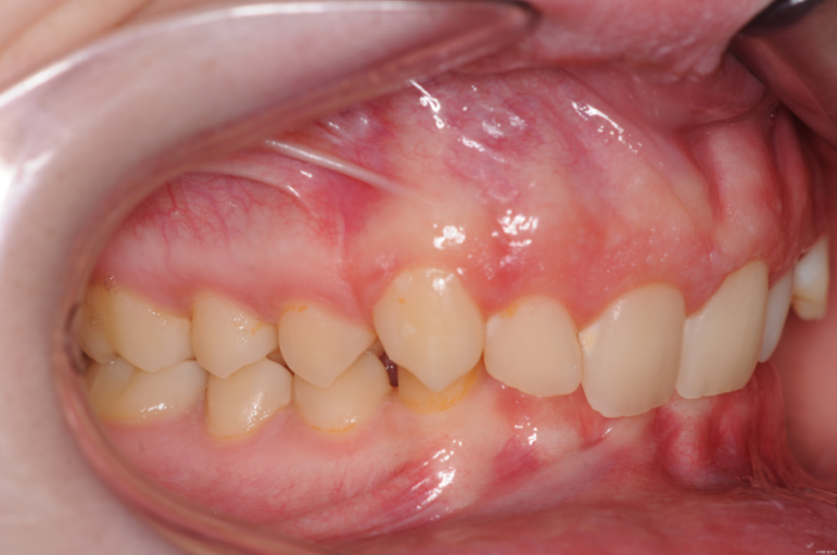
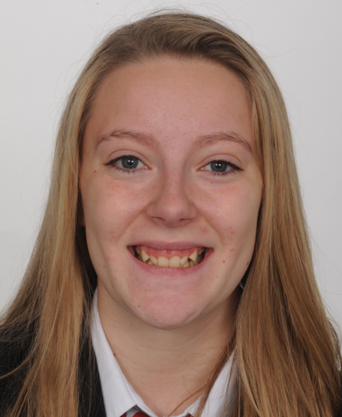
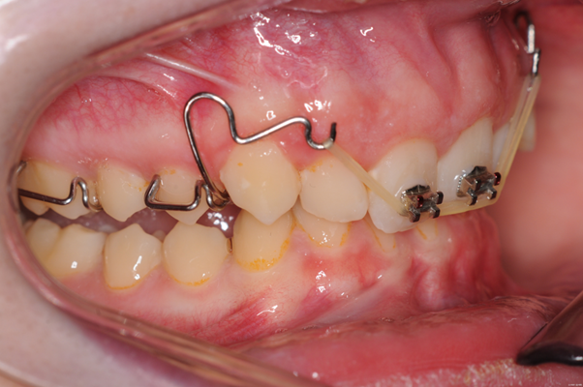
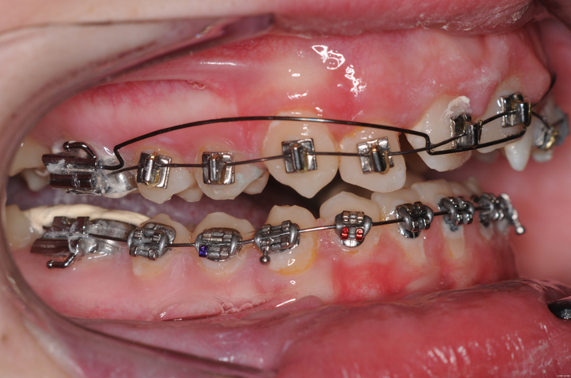
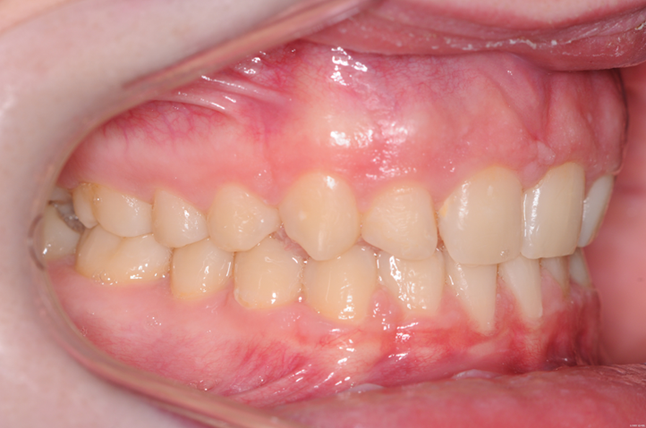
URA to extrude or intrude incisors

Slide 14
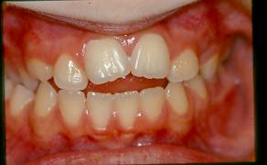
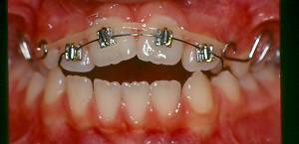
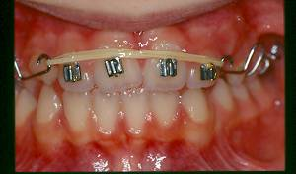
Gummy smile. This simple appliance can be used to move the incisors up until 3mm shows with the lip at rest. Then hold with a stabilizing arch. Or a TAD, or a counterforce arch
Same appliance can be used to extrude the upper incisors. Until 3-4mm shows with the lip at rest

Slide 15

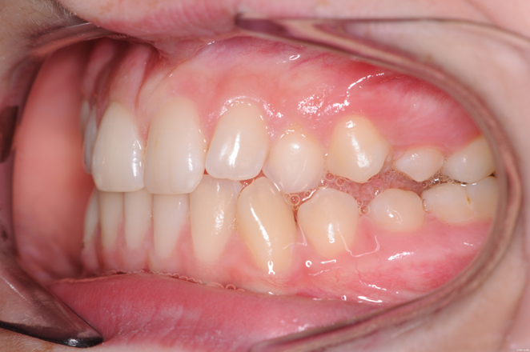
URA to the rescue

Slide 16
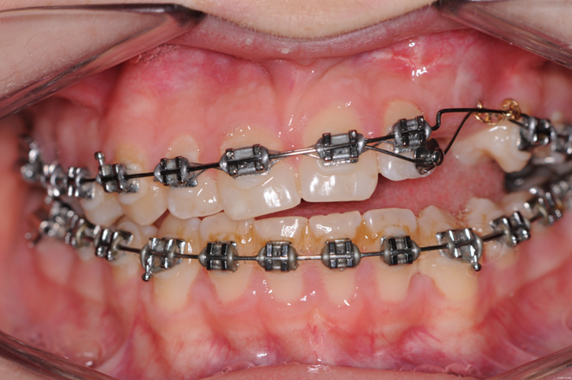
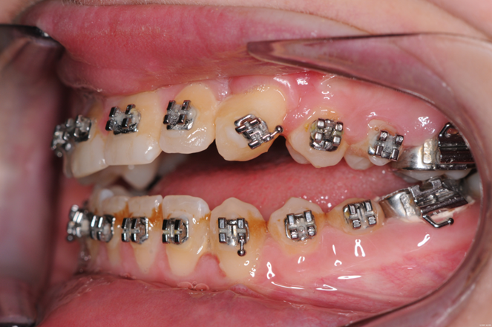
You don’t often need this URA but when you do it is great to know it is there. This canine came down but with some intrusion. Don’t use elastics they will tip the occlusal plane.

Slide 17
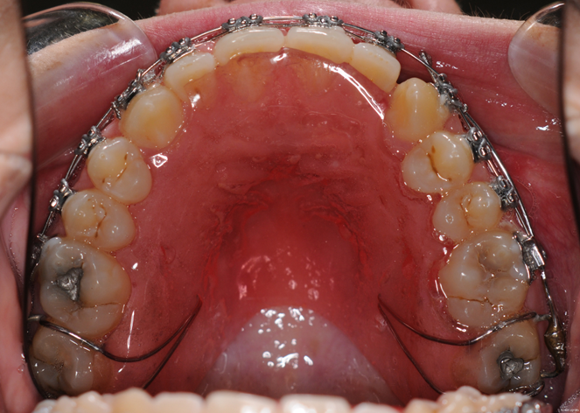
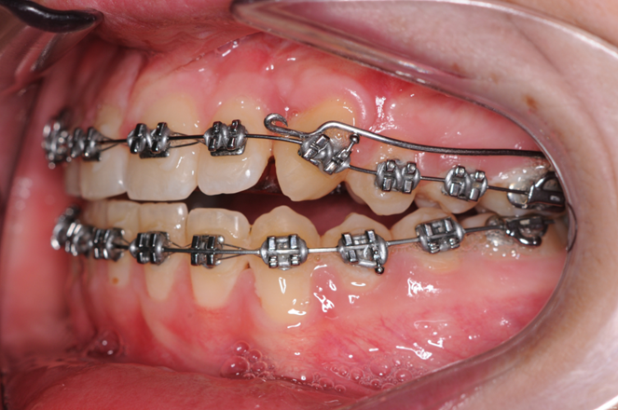
It is a simple plate with cribs on 7s and arms to extrude the canines without tipping the occlusal plane

Slide 18
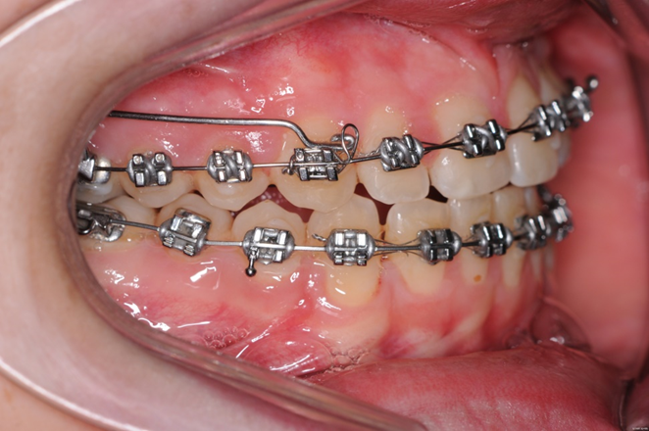

Slide 19

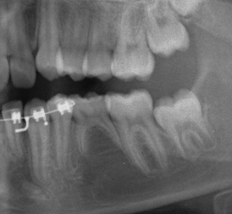
Modified Pedro mechanics
Simple idea where a tooth is missing and you have a wisdom tooth.
Take out the E
Tip 6 forward with Buccal and Lingual elastics (with no archwire between 6 and 4). Supporting with short class II elastics
Continue with short class II support. Tie all teeth together. Upright using NiTi wire

Slide 20
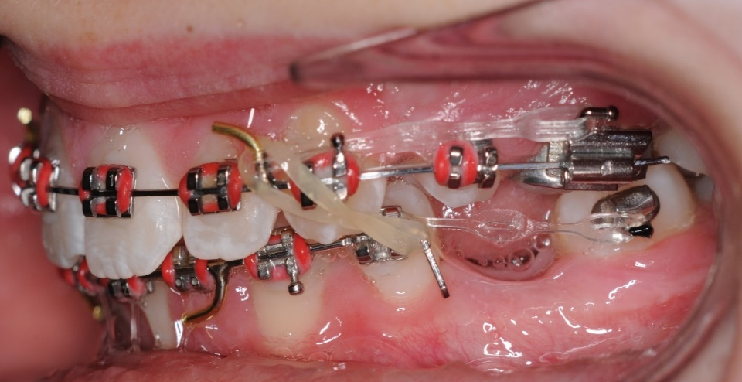
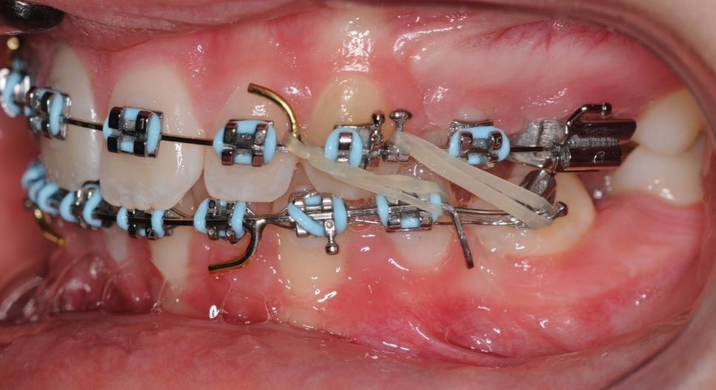
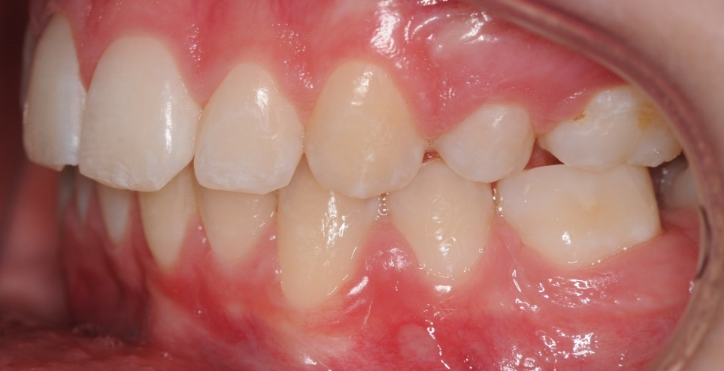

Slide 21
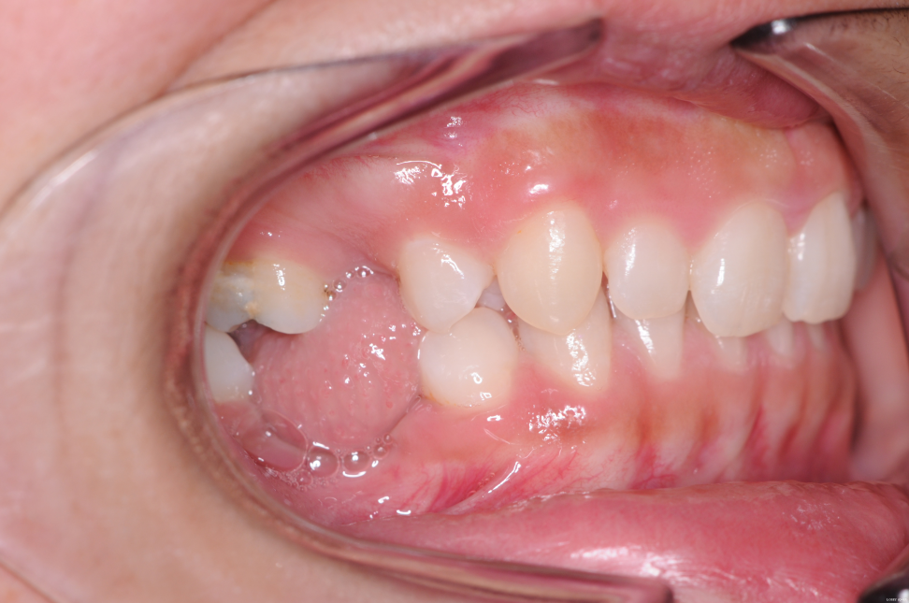
Missing lower right 6 & 5 ( so 3 units in the lower)

Slide 22
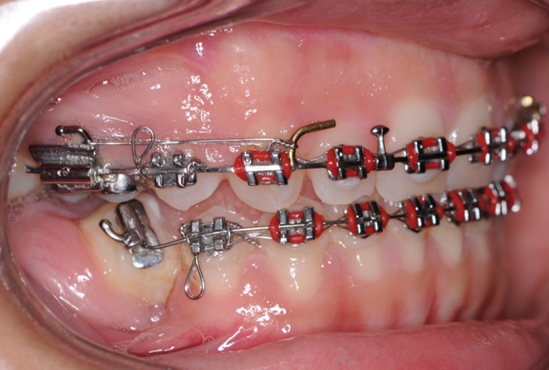
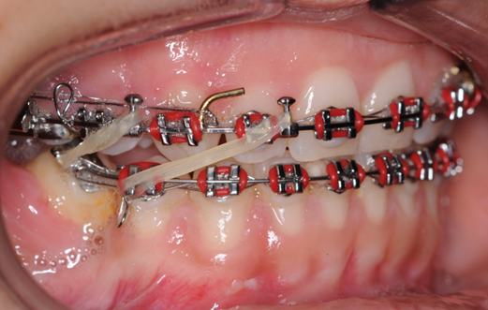

Slide 23
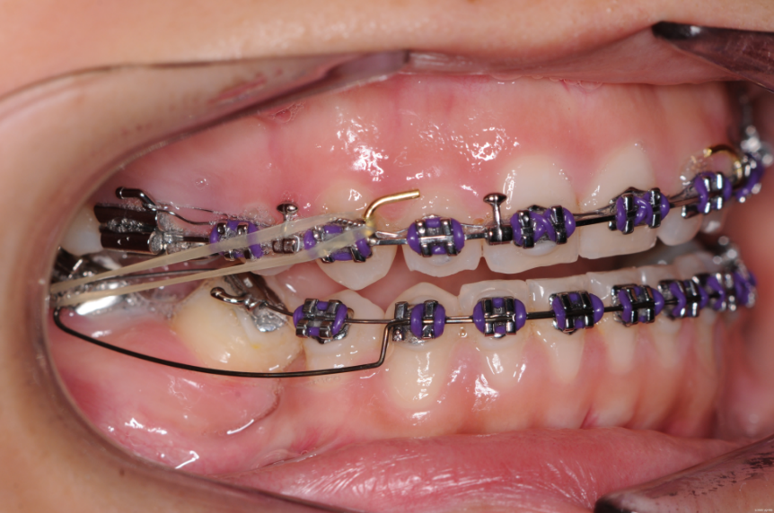
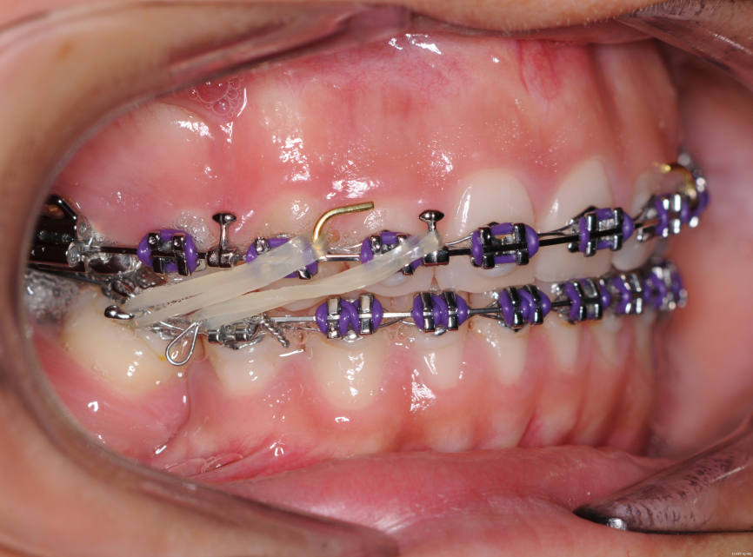
Lower 8 erupts

Slide 24
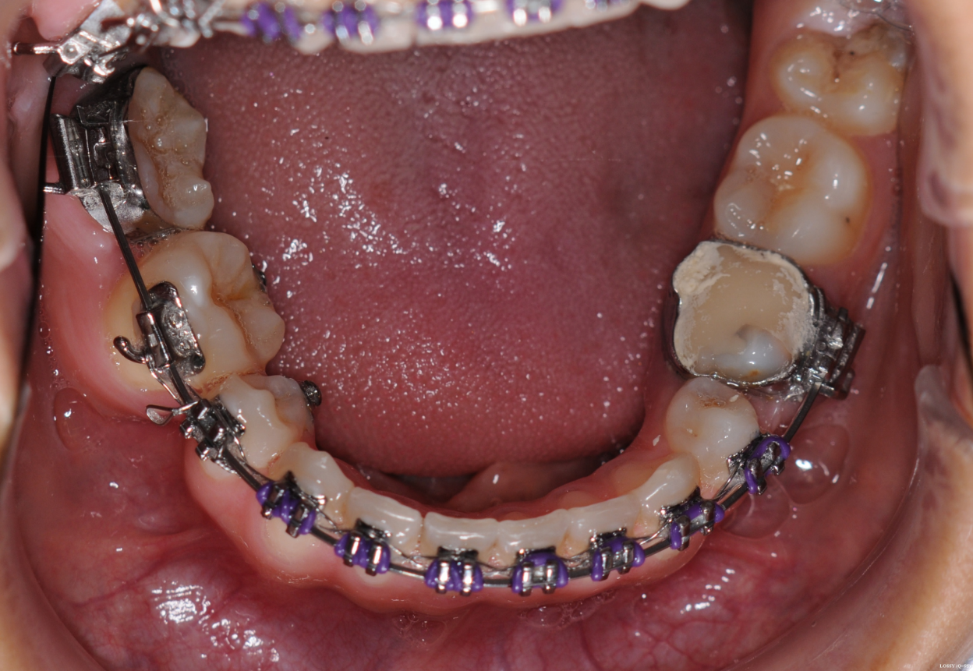
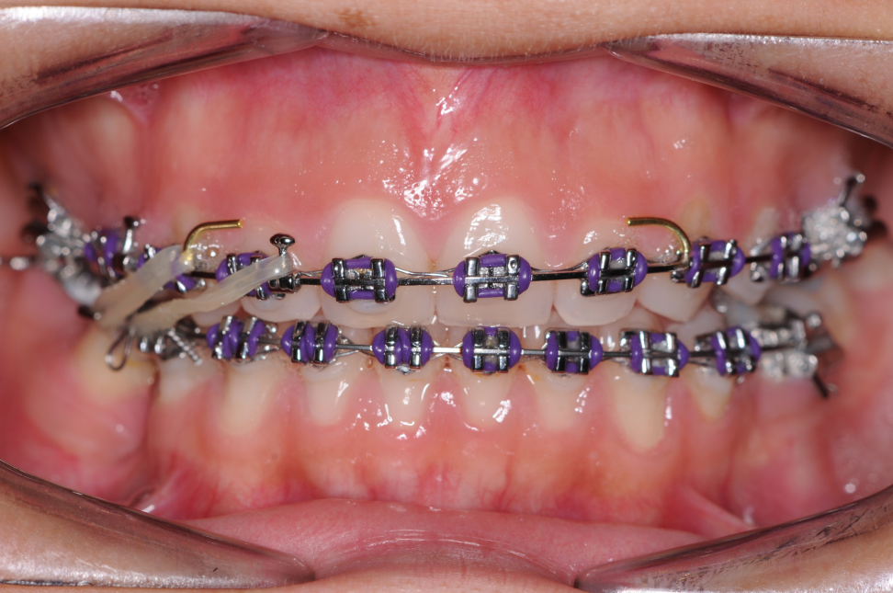
Don’t put in 0.016 x 0.022 Niti wire too soon or you will see some root resorption. Note centreline remains satisfactory.

Slide 25
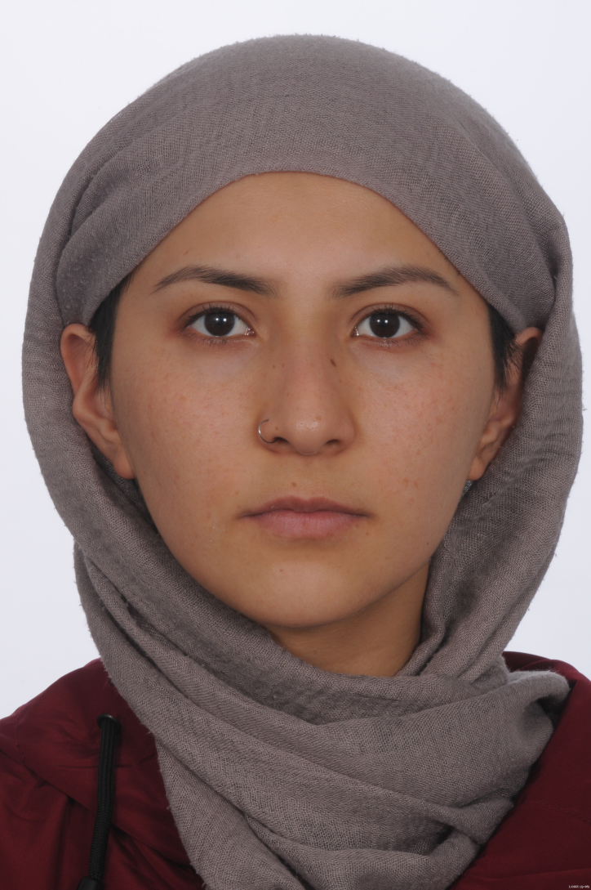
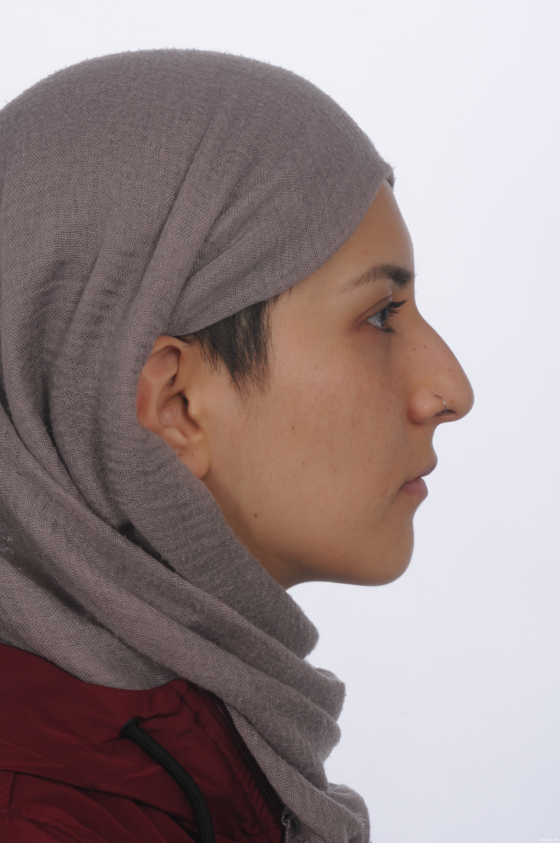
Does not dish in

Slide 26
Next Case
Racebacks

Slide 27
Lower arch crowding
Missing LR5 (Has third molars)
Because of the missing LR5 a decision to extract 5s and LRE leaves excessive space. Racebacks use excess anchorage and speed treatment

Slide 28

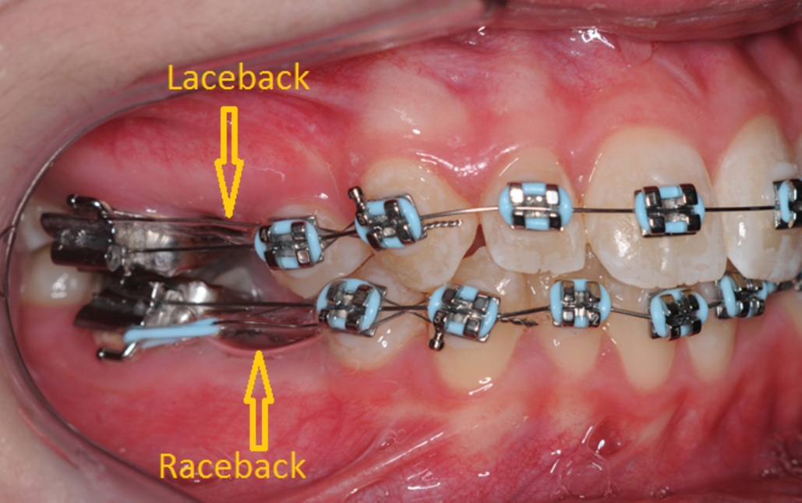
Race-backs

Slide 29
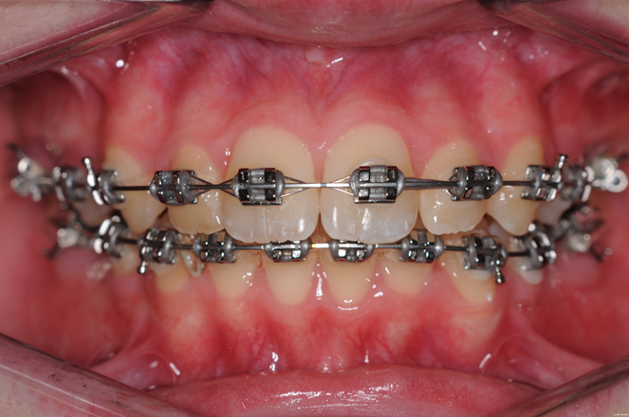
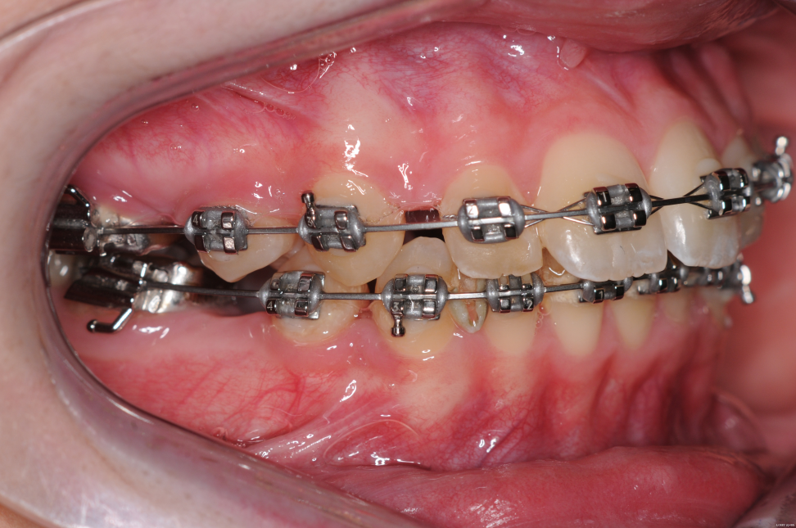
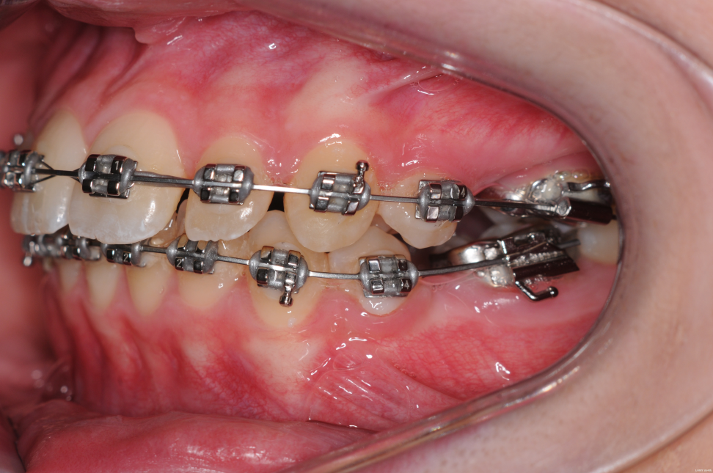
Next Visit

Slide 30
The use of a raceback really speeds up incisor alignment

Slide 31
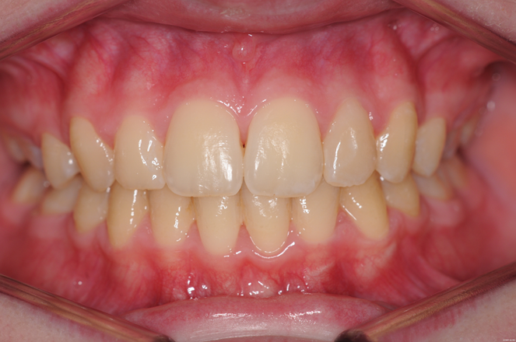
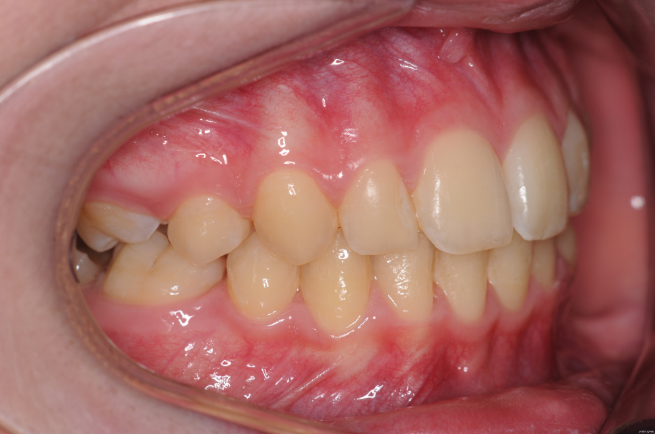


Slide 32



Note no dishing in

Slide 33


Split Essix

Slide 34




Mild crowding. Open enough space using screw plates or strip the teeth
20 years ago

Slide 35


Take imps. Reposition the teeth on the model and make two Essix retainers ( 0.030) for each jaw. One of which is split along the incisal edge 3-3. Wear the split one full time for 2 weeks and then the un-split one for 2 weeks

Slide 36




No enamel has been damaged in the making of this occlusion

Slide 37



Upside-down counterforce
AOB with reduced incisal show

Slide 38




Slide 39



Counter-force archwires upside down with vertical elastics to extrude the premolars

Slide 40




Slide 41


6 months after treatment

Slide 42



Modified Ballista
Pulls down palatal canines, opens space and centres the canine between 2 and 4 all at the same time.
To make the button pull a module over the wire and cover with flowable composite. Joining it to the push-coils makes it easier to place in the mouth.

Slide 43

catapult

Slide 44





Cement on 7s

Slide 45
Using cement to open the bite
You use Straight –wire but the wire isn’t straight it is FLAT. (Flat wire doesn’t sound so good) If the wire is flat, you get the right tip and torque on every tooth. If you open the bite with bite opening curves you get the wrong tip and torque on every tooth and in particular it proclines and expands lower 3-3. It also impedes sliding mechanics.
Don’t bond the 7s and place cement on the occlusal surface to exactly open the bite. Then use elastics (usually class II) which lift the lower 6s.
It opens the bite and because the incisors are out of contact it speeds up overjet reduction.
You must remove the cement on the 7s when the 6s are in contact

