Slide 1
Version with text for web –site added text on pink slides
Fiction in Orthodontics
D Spary

Slide 2
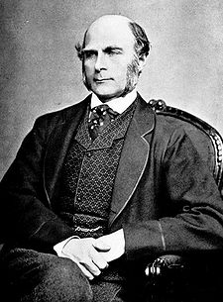
Francis Galton 1822-1911

Slide 3
Francis Galton
Mathematician and scholar who invented many statistical tests. He was also a pioneer in early photography. His idea was to produce average pictures of criminals to aid their detection.

Slide 4
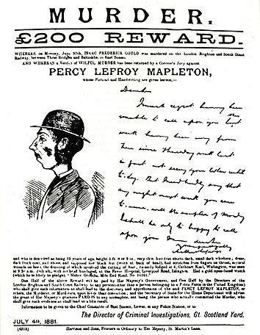

Slide 5
But to his surprise he found the more pictures he averaged the better looking the composite picture became.
And this is the basic principle of planning for orthognathic surgery the more “average” you make people the better looking they become

Slide 6
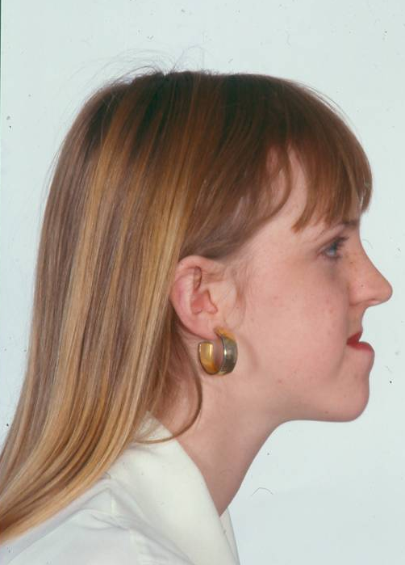
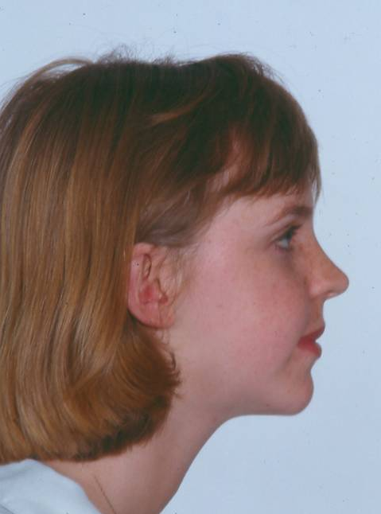

Slide 7
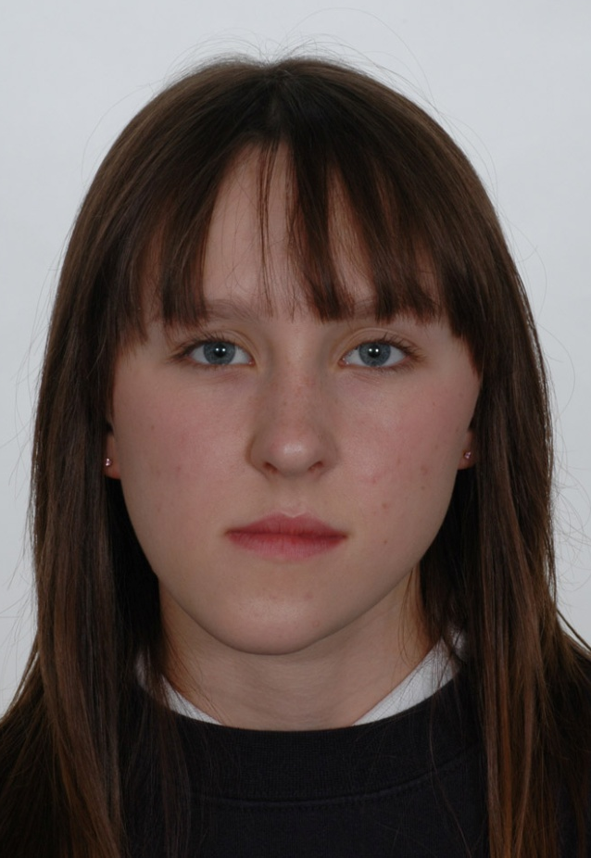
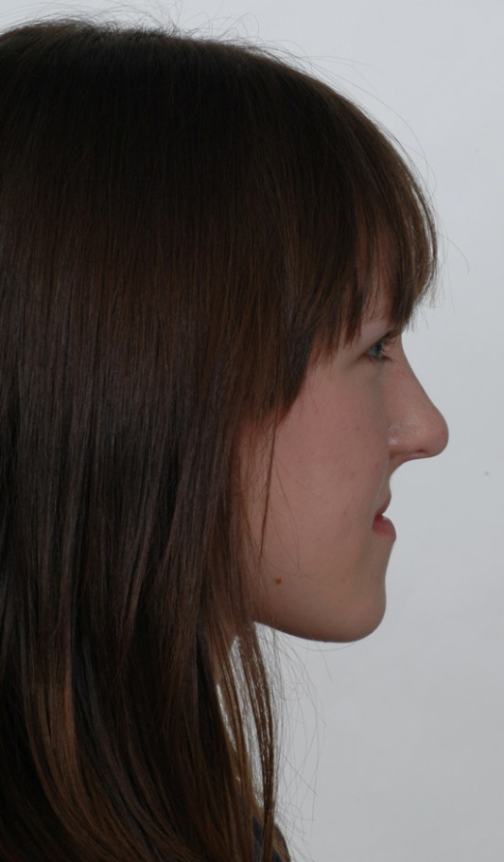

Slide 8
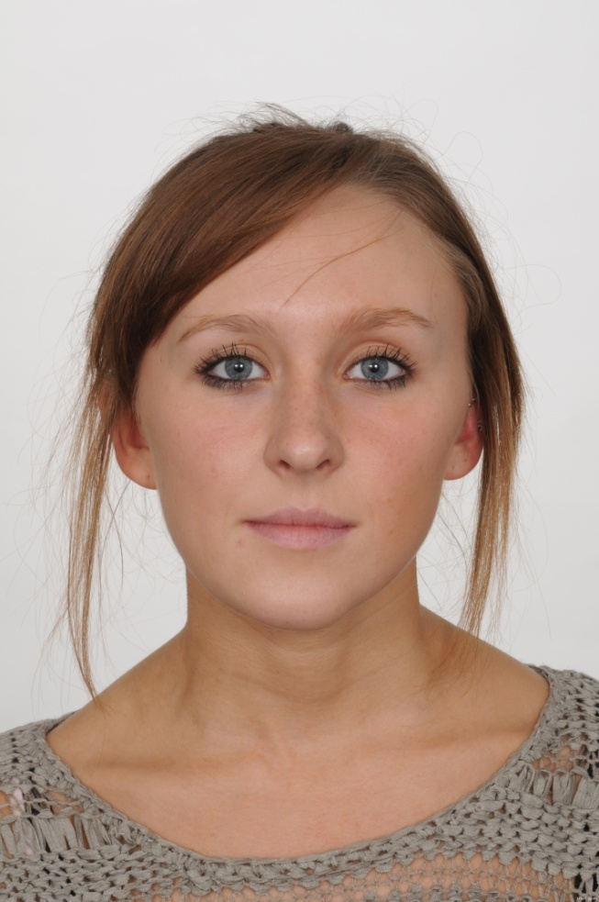
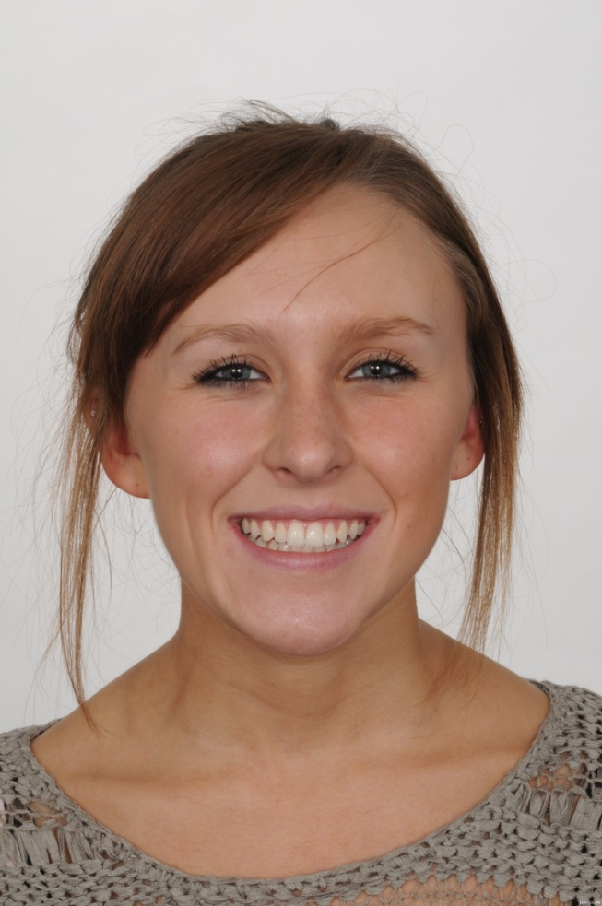

Slide 9
So for maximum good looks
Go for average with a smile
But remember a smile is a peculiarly human trait . When animals show their teeth it is a sign of aggression.

Slide 10

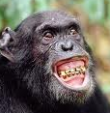
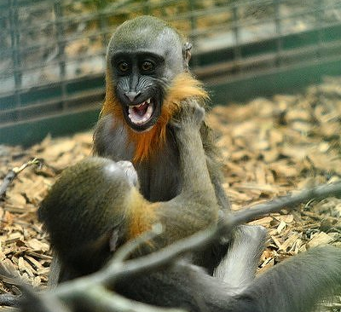

Slide 11
Langlois, J. H., & Roggman, L. A. (1990). Attractive faces are only average. Psychological Science, 1, 115-121.
Composite faces were judged as more attractive than the individual faces comprising the composites. A strong linear trend also revealed that the composite faces became more attractive as more faces were entered..

Slide 12
However average can be used as a trick
Phil, the power, Taylor if asked to throw a dart near to the centre might get very close. But given 100 darts the novice covers the entire board. His average is the entire centre making it appear he is better than Phil Tayor

Slide 13
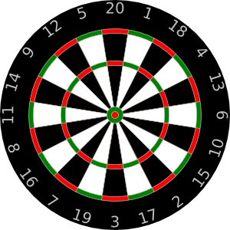
The trick of averages
Phil “the power” Taylor

Slide 14
The trick of averages

Slide 15
Some papers on bracket bonding have this error
But most importantly Dick Mills' classic paper uses a trick of the average

Slide 16
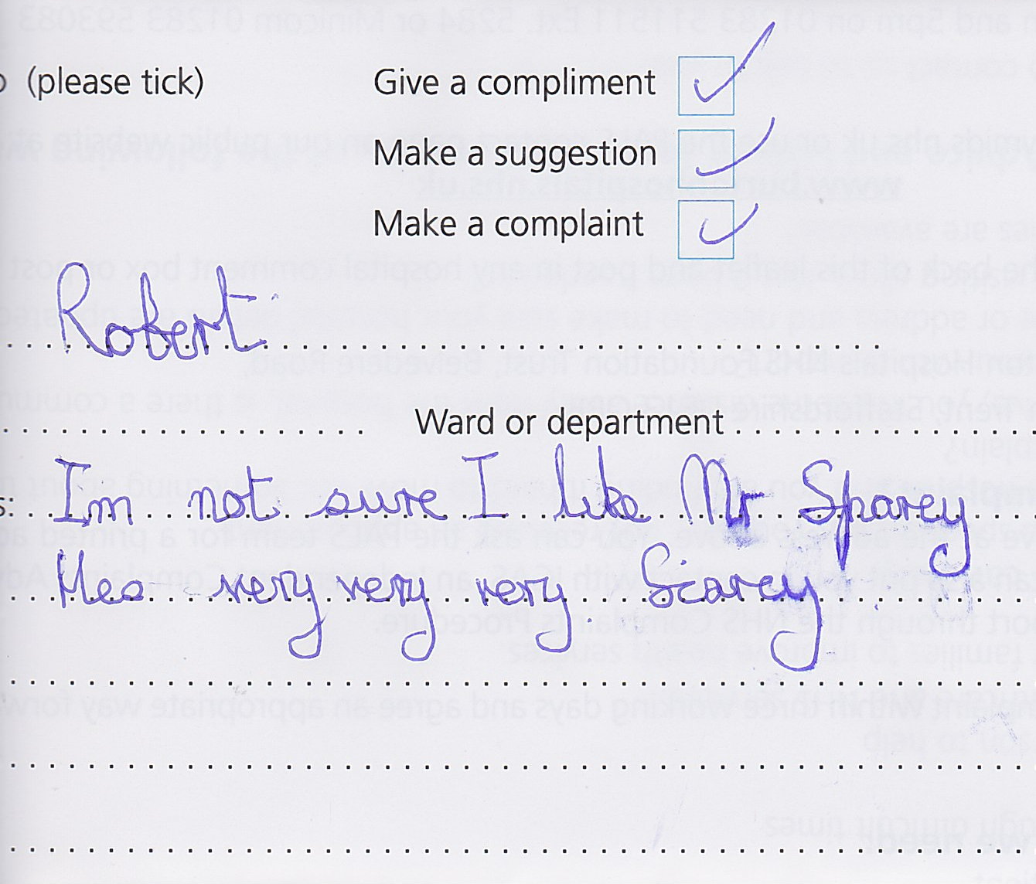
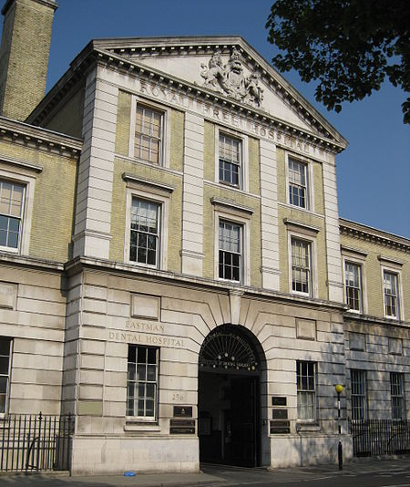
Clifford Ballard and Dick Mills
James Richard Ewart Mills

Slide 17
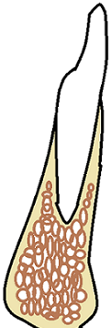
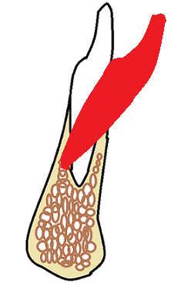
Mills looked at patients where the lower incisors were proclined during treatment

Slide 18
What happened afterwards

Slide 19
Some went back to the original position
Some actually proclined
And some dropped back even further than the original position

Slide 20
By using an average Mills gives the impression of a stable Zone which is not really demonstrated by the research
This does not mean that there is no such zone it just means we have no proof it exists

Slide 21
So on average they moved to the original position.
This is the basis of all orthodontic diagnosis!

Slide 22
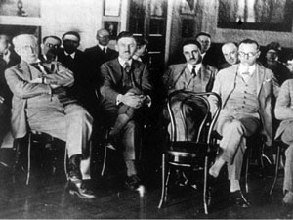
Who was the most famous orthodontist in Australia in 1952?

Slide 23
PR Begg (sitting behind the empty chair)
Begg was a student of Edward Angle. Trained in Non extraction Ribbon arch and the new Edgewise appliance.
He did a doctorate looking at the skulls of ancient aboriginal people
They had a lot of attrition

Slide 24


Slide 25
Begg concluded
That the attrition was exactly one premolar width and this justified premolar extraction
There are those who doubt that research ever works out as exactly as this and suggest Begg wanted to extract teeth and massaged his results a little.

Slide 26
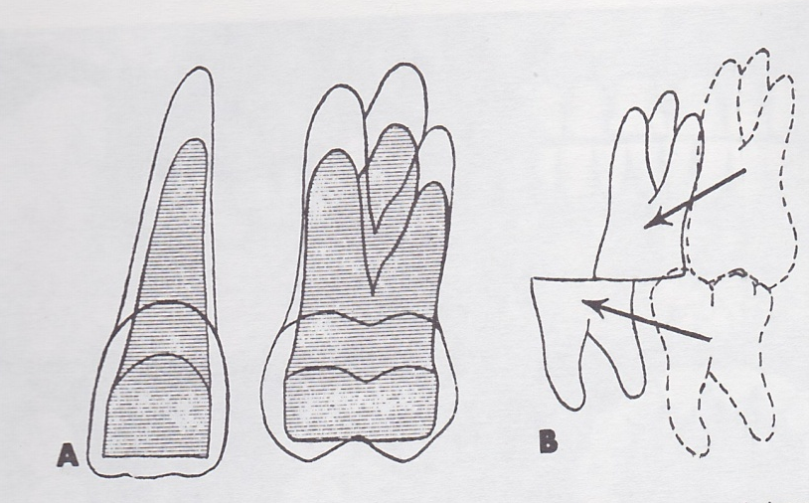
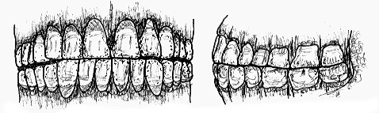
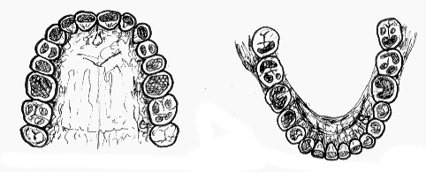

Slide 27
Begg was a towering figure in Australian Orthodontics
He agreed with Schwartz that orthodontic forces should be less than capillary blood pressure.
And with Reitan that hyaline areas slow down tooth movement
From this he developed his theory of differential anchorage. Light forces will retract the incisors and heavy forces will bring the molars forwards

Slide 28
Storey and smith’s results
Exactly fit with Begg’s idea.
But all subsequent research suggests that in fact higher forces move teeth faster

Slide 29
Storey and Smith Australian Dental Journal 1952
Reitan K
1951
Begg P R differential tooth movement
Schwarz A M capillary blood pressure in the periodontium 1932

Slide 30
LEE-ANDREASEN | 400CN MOVED TEETH 2.5 TIMES FASTER THAN 200 CN
HIXON | FROM 0-1500 CN THE GREATER THE FORCE THE FASTER THE TOOTH MOVEMENT
BOESTER | HIGHER FORCES MOVED TEETH FASTER
OWMANN-MOLL | 200CN MOVED TEETH 50% FASTER THAN 50CN

Slide 31
Ricketts in his bio-progressive technique uses the idea that the optimum force for tooth movement equates to the cross sectional area of the tooth times capillary blood pressure.
This results in using very light forces and to prevent over activation Blue Elgyloy wires were used
The wire was so soft that many patients just chewed their appliances to pieces in a day or two

Slide 32
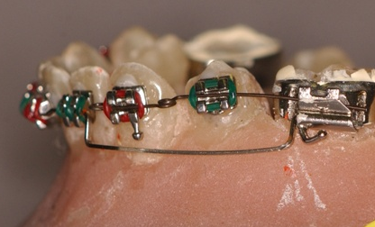
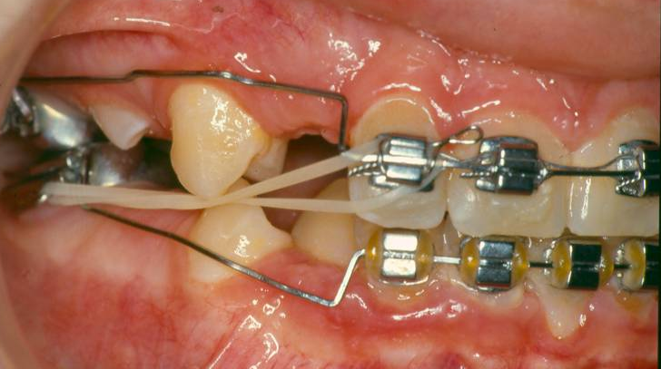
Intrusion forces with Ricketts utility
ricketts

Slide 33
Which brings us to the next fiction
You must open the bite in adults by intrusion
W Houston 1970-75

Slide 34
Actually I was working in Prof Houston’s department at that time and he never mentioned it to me
I don’t believe there is any evidence to support this.
Certainly the face height wil return to the original but if the patient is wearing Essix type retainers the overbite remains un altered
The following case was 59 at the start of treatment. Overbite reduction remained 5 years after treatment

Slide 35
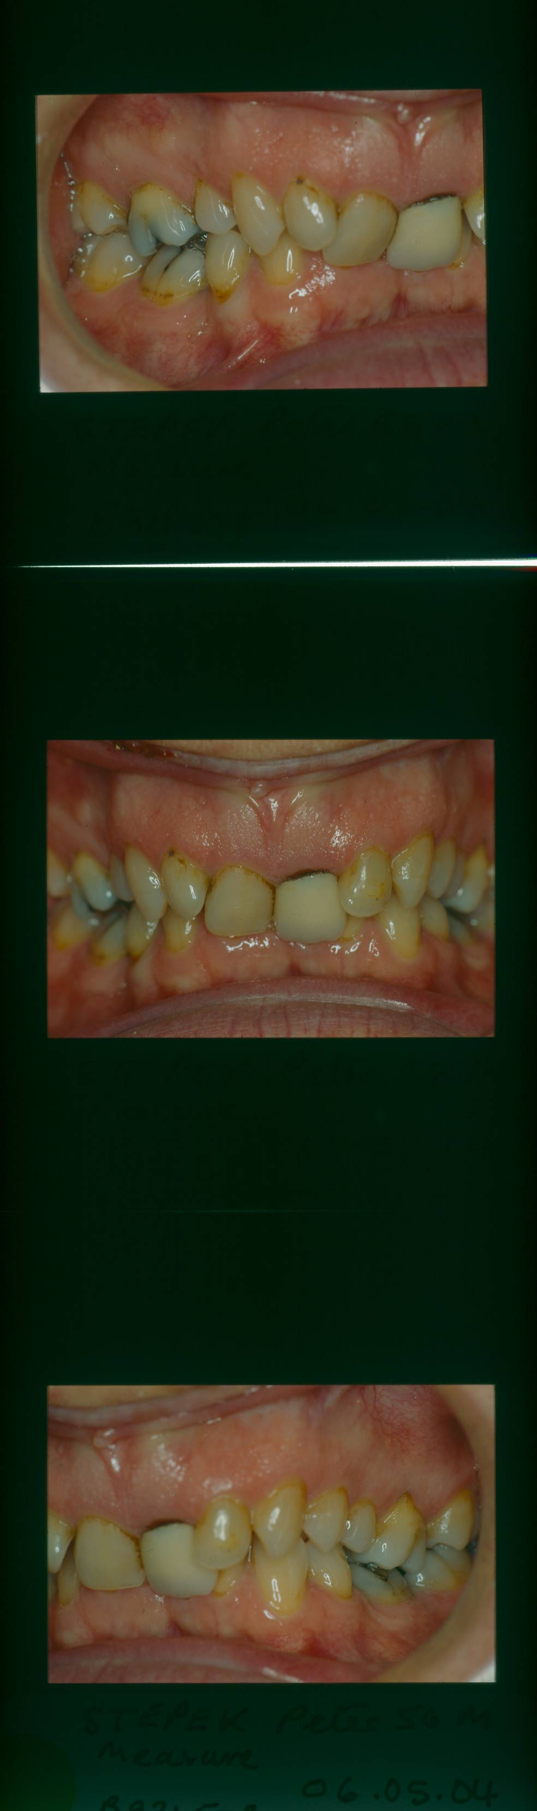
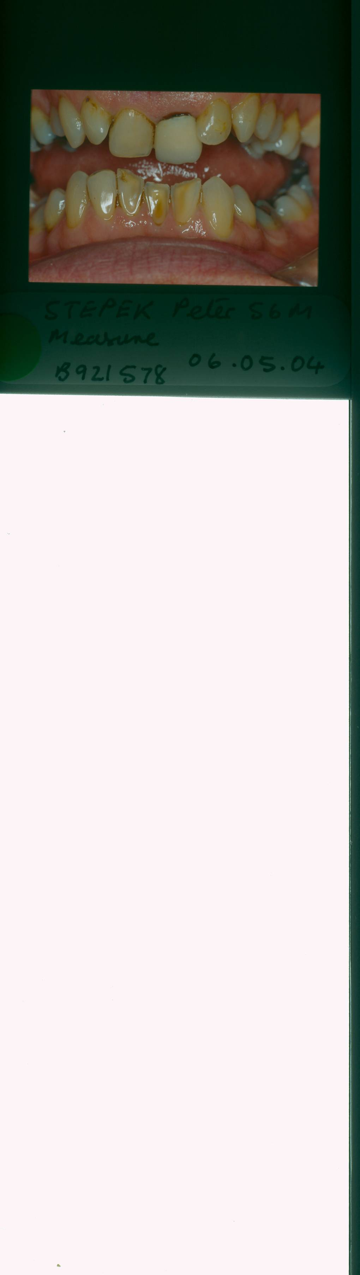
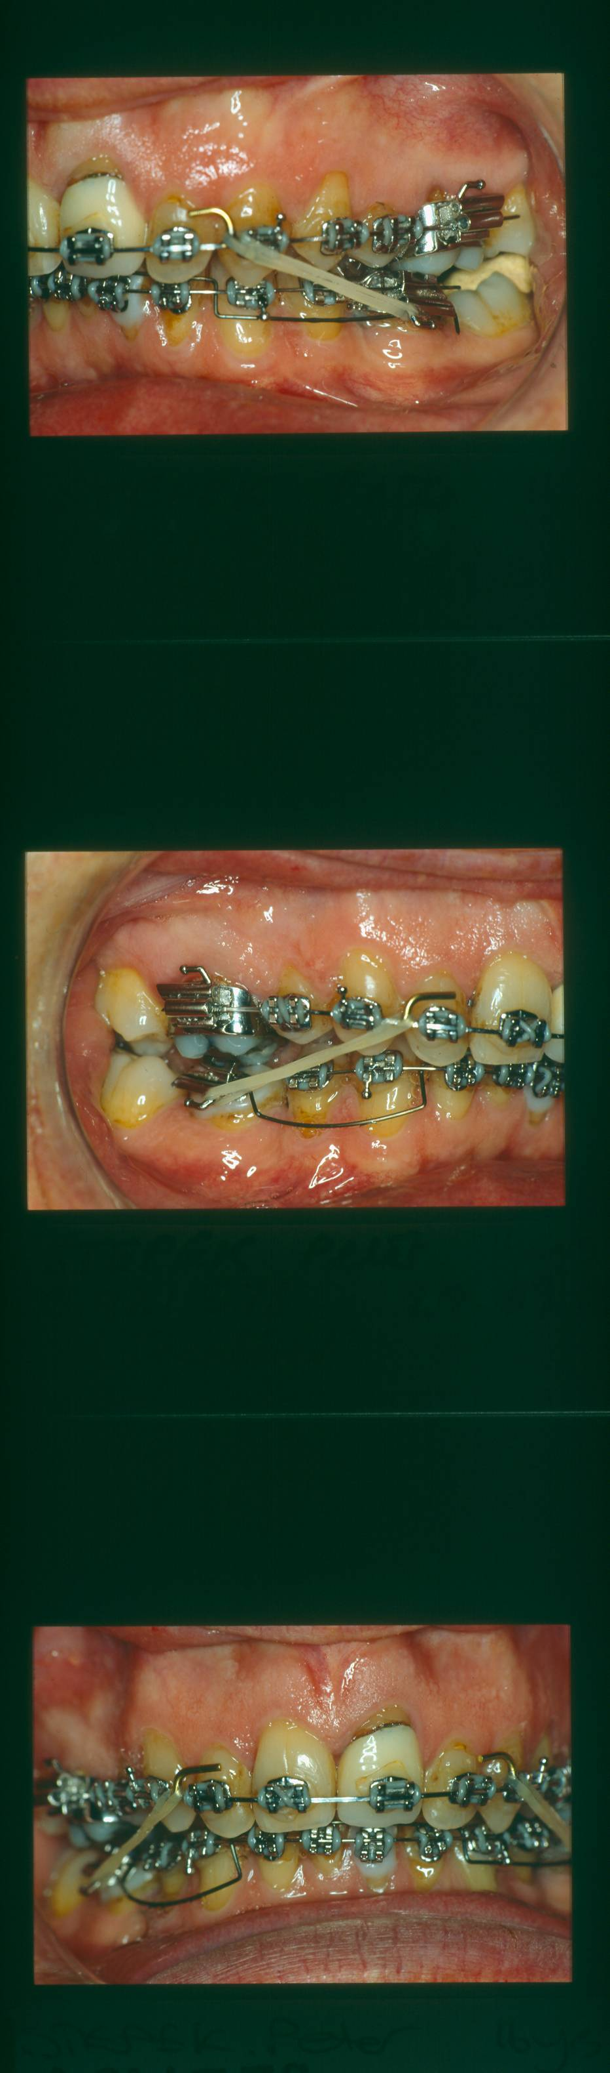
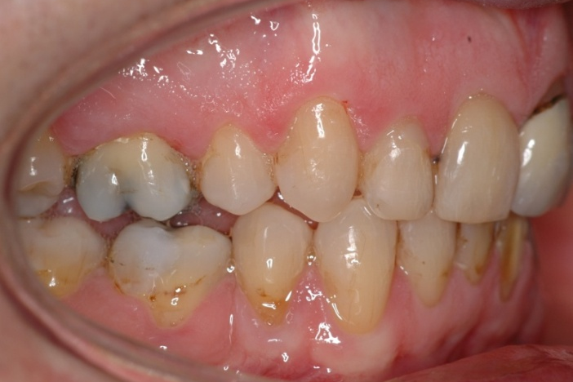
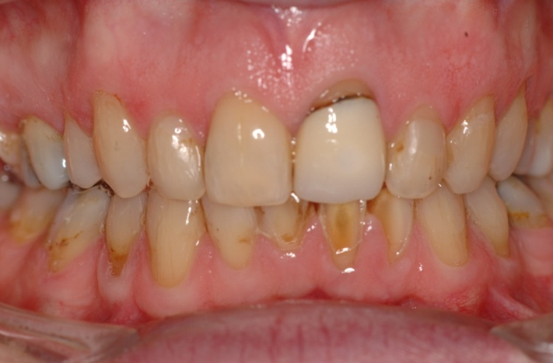
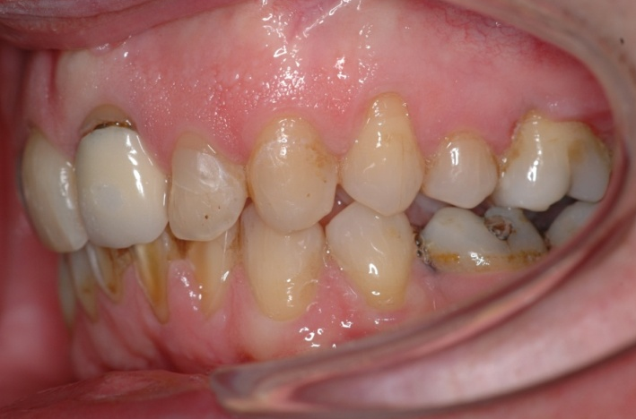
Notes:
Note similarity to Helen Taylor’s arch

Slide 36
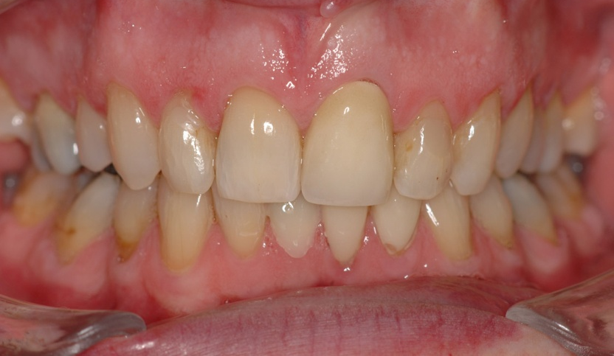
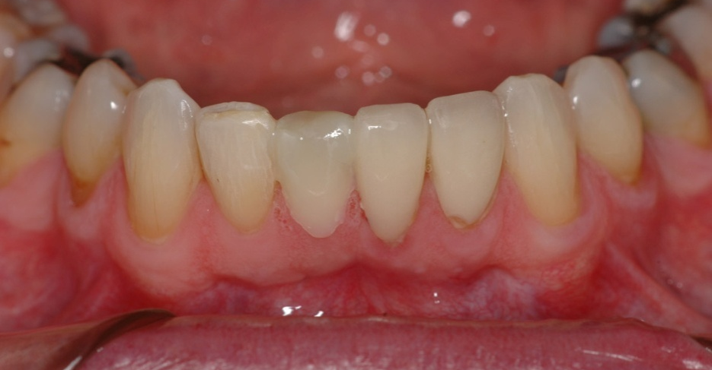
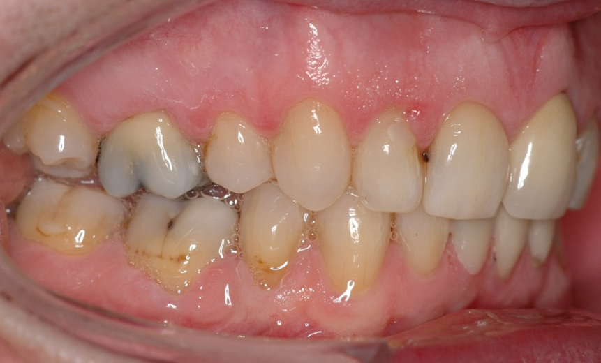
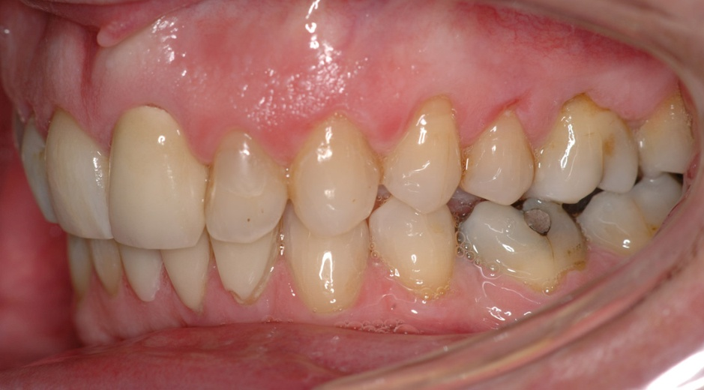
5 years post treatment

Slide 37
Orthopaedic change
Headgear for 3 years before orthodontics.
RME and airway.
Frankel Appliance.
Twin block.

Slide 38
Tricks with functional appliance
Growth.
Only including successful cases.
Growth spurt.
Cephalometric tricks:
Multiplication
Drop a vertical
Dual bite

Slide 39
For over 100 years orthodontists have been claiming that their appliances produced orthopaedic change
Angle claimed to bend bones
Frankel thought by stretching the peri-osteum bone was produced
Haas felt RME would improve the airway ( now we believe airway obstruction is in the adenoid area unaffected by arch expansion) and Proffit has shown most orthopaedic change related to RME dissappears in the retention stage.
O’Brien shows that 70% of the change in Twin Block therapy is dento-alveolar. That means that 10 mm OJ is reduced to 2mm 5.6 mm of this change is dento alveolar . WHAT IS THE OTHER 2.4mm? Well in a growing individual the mandible usually grows a little more than the Maxcilla let us say 1mm. So what is the remaining 1.4 mm? Well it could be skeletal change but it could be posture

Slide 40
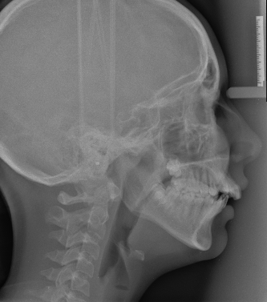
Start Ceph from Spary and Barreto

Slide 41
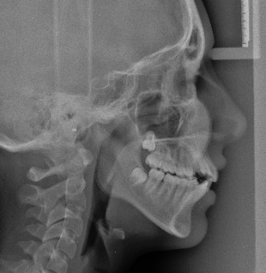
Final ceph but this did not fit with clinical observation

Slide 42
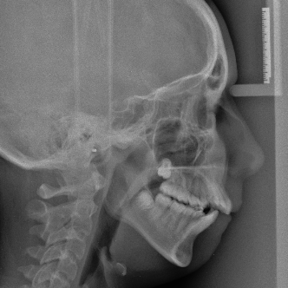
It was just posture. What would happen if a few such patients were included in the results of a trial

Slide 43
But do we even know if camouflage TREATMENT IS A BAD IDEA?

Slide 44
At the BOC 1995
I showed 7 cases

Slide 45
Treated by 7 different methods
1. Functional Appliance + Fixed
2. EOT + Fixed
3. Begg
4. Tip Edge
5.Orthognathic Surgery + Fixed
6. Herbst+ Fixed
7. URA

Slide 46
All 7 cases had overjets between 10 and 16 mm at the start.
The surgical case had a 10mm Mandibular advancement

Slide 47
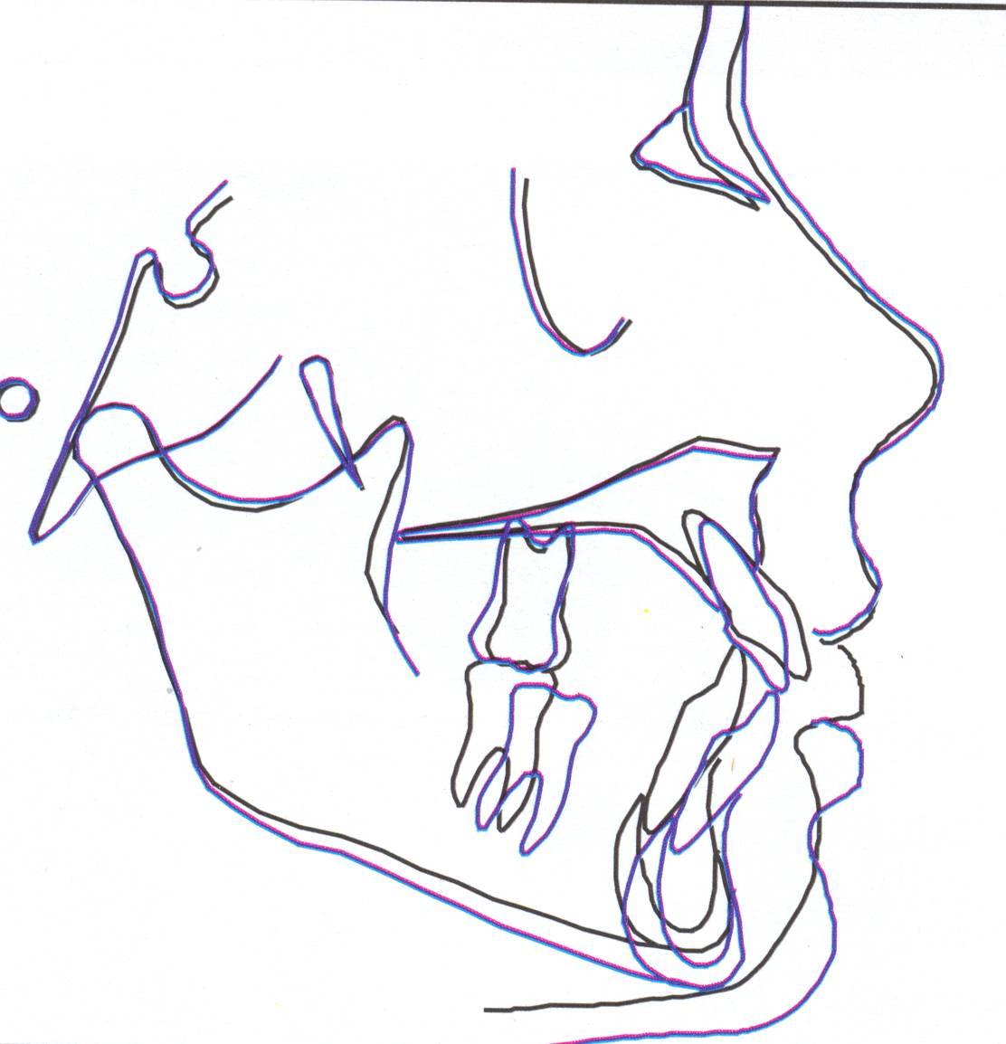
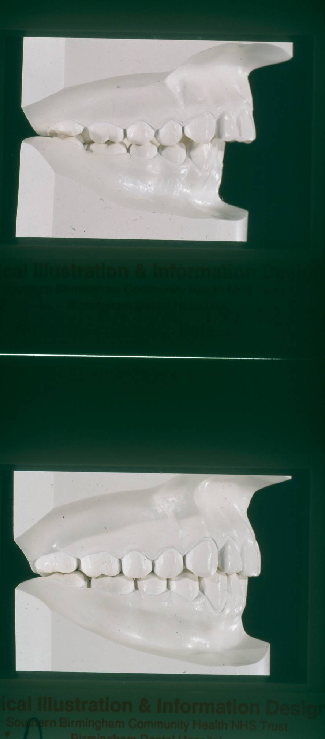
They had the models before and after and tracings of the Ceph

Slide 48
Surgery changes the underlying bone a great deal.
EOT restricts maxillary growth.
Functional appliances encourage mandibular growth.
Begg and Tip-Edge are camouflage only.
Begg gives poorer finishing.
URA’s only tip teeth.

Slide 49
So it should be possible to tell which case was treated with which appliance.
But was it?

Slide 50
50 Orthodontists tried the challenge.
A challenger was juged to be an Orthodontist if they had at least 23 months in full time orthodontics

Slide 52
So just 5 of the 50 orthodontists correctly identified the Tip Edge case

Slide 53
Surgical case

Slide 54
At first sight this looks impressive.
But it means that even with the models and tracings 60% of orthodontists could not tell a case, that had had the maximum possible mandibular advancement, from a simple orthodontic case.

Slide 55
Correct Guess

Slide 56
Contestants score
Nobody got all 7 correct and one orthodontist scored zero

Slide 57
Which was the best case?

Slide 58
Irritating to know
That massive surgery doesn’t necessarily produce better treatment.

Slide 59
Normal ANB 2-4⁰with sd 2⁰ the cases show all have an SNA near to 81⁰
Only one of these 8 patients is more than 1 sd from normal. Which one is it?

Slide 60
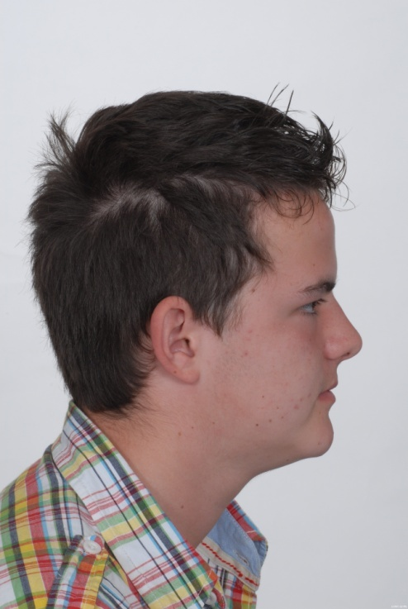
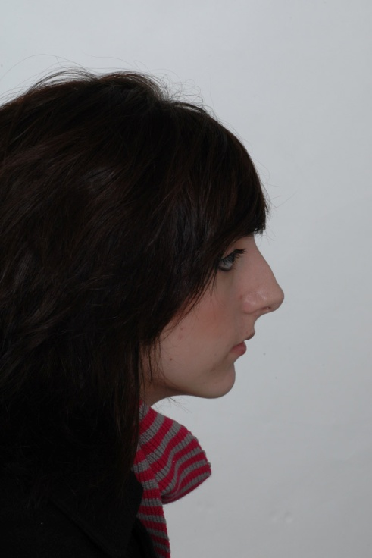
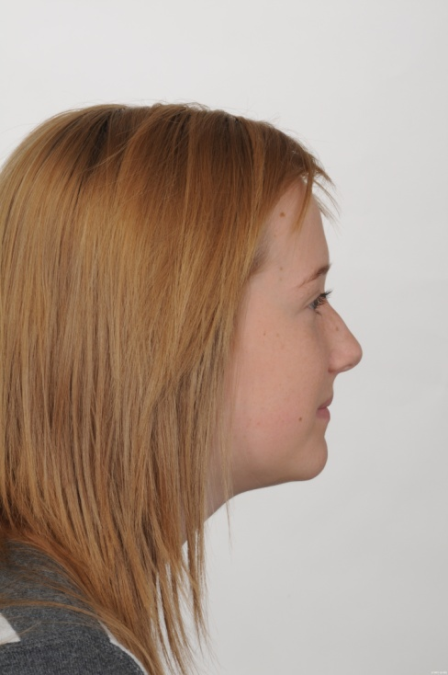
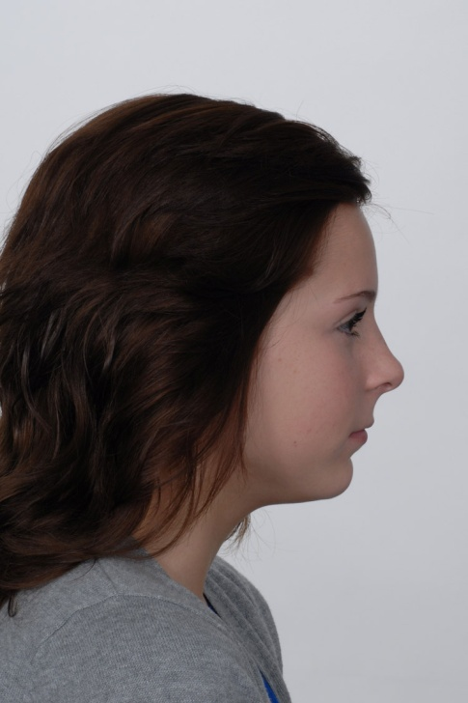
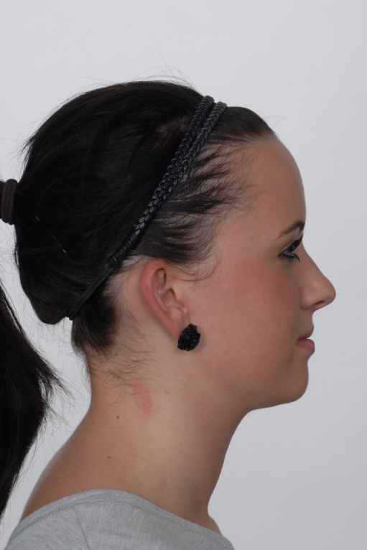
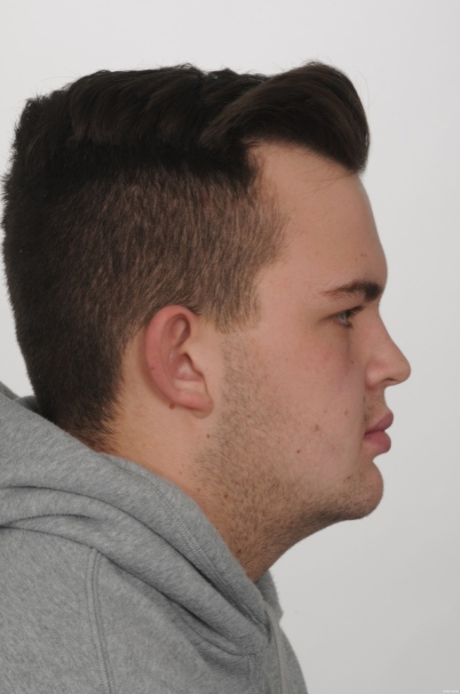
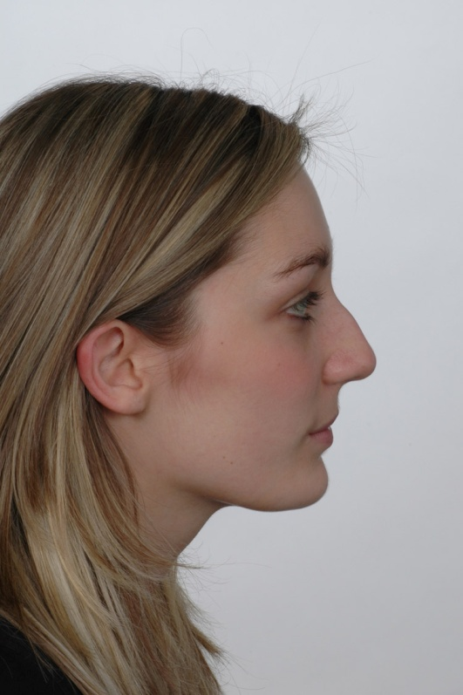
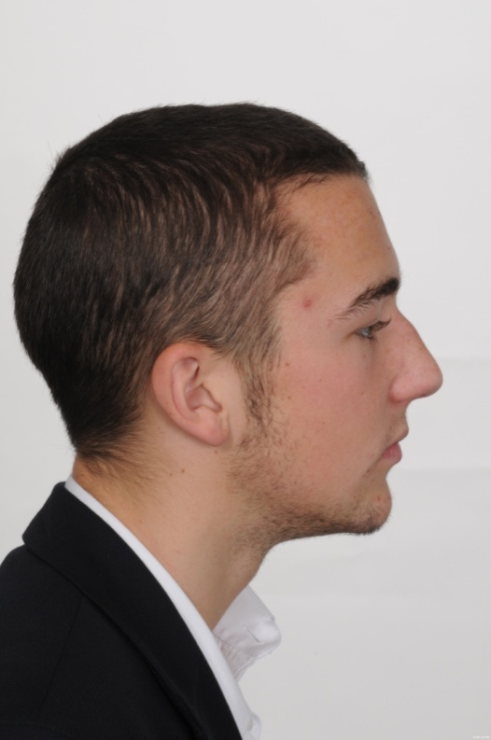

Slide 61
ANB=1
ANB = 4.5
ANB=4
ANB = 6
ANB=0
ANB= - 4
ANB=3.5
ANB =5.5

Slide 62
If you couldn't guess the correct one
Should you be refusing to do camouflage treatment
the most popular choice is patient number 2 she has an ANB angle of 4.6⁰ with an SNA of 81⁰

Slide 63
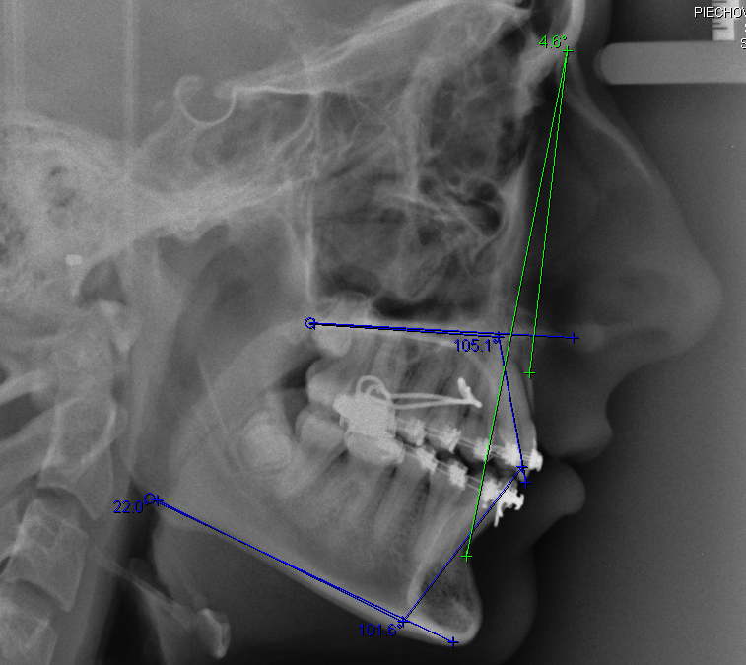

Slide 64
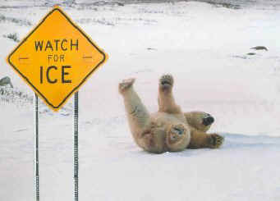
Friction and self ligating brackets

Slide 65
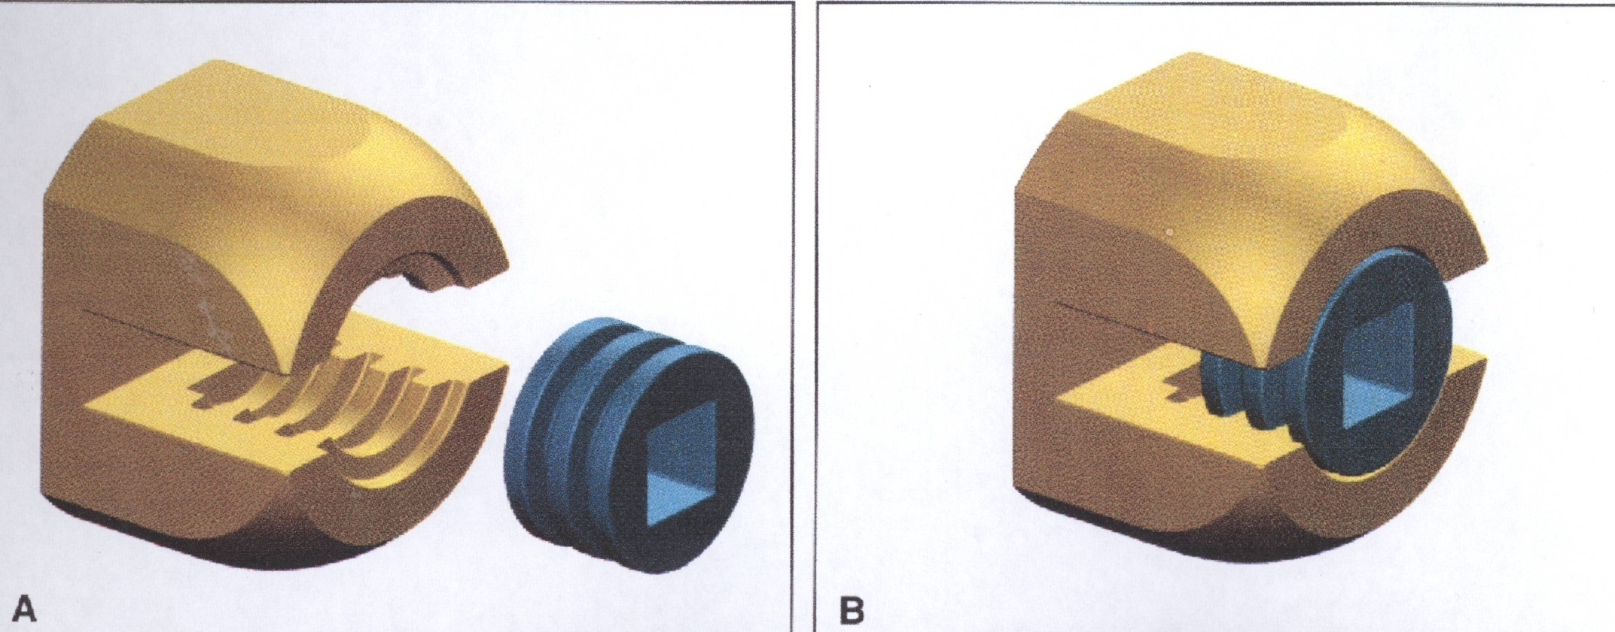
Russell bracket 1935 .Orthodontists should be proud that the first ligature free bracket appears only 7 years after the development of the edgewise bracket

Slide 66
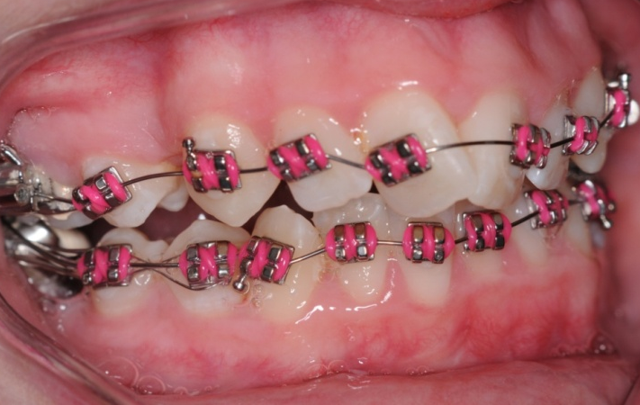
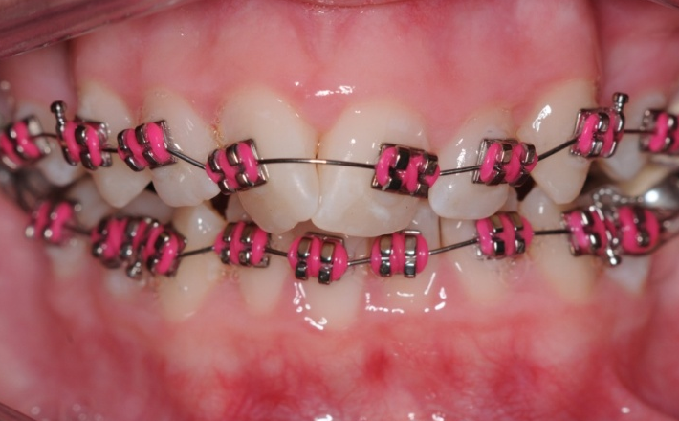
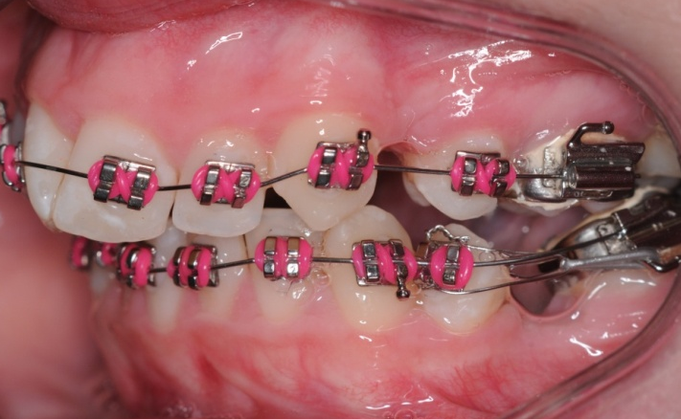






Slide 67
However if you use figure of 8 modules
It increases the friction.
But it doesn’t seem to slow up the alignment

Slide 68




Ong (2011) compared alignment, arch widths and spontaneous extraction space closure. He found no difference between Damon and conventional brackets.
Ollivere (2012) published two studies of consecutively treated premolar extraction cases and in both cases found no significant difference in treatment time with his switch to active self-ligation.
All the currently published random controlled trials (Miles 2005, Miles et al 2006, Pandis et al 2007, Scott et al 2008, Fleming et al 2009, Fleming et al 2010) have found no overall benefit in the alignment phase, although Pandis found that mild crowding was eliminated 2.7 times more rapidly with Damon 2 than conventional brackets.

Slide 69
Two spilt mouth studies (Burrow 2010, Mezomo 2011) of the rate of canine retraction on 0.018” stainless steel failed to find faster retraction with self-ligation .
Chen et al (2010) and Fleming and Johal (2010) carried a systematic reviews and concluded there is insufficient evidence to support the view that treatment with self-ligating brackets is more or less efficient than with conventional ligation.
Fleming P. Johal A. ‘Self ligating brackets in Orthodontics’ Angle 2010 Concluded insufficient high-quality evidence to support the use of self-ligating fixed orthodontic appliances over conventional appliance systems.

Slide 70
Conclusions
There is insufficient evidence to support the use of self-ligating fixed orthodontic appliances over conventional appliance systems or vice versa.
SLBs do not confer particular advantage with regard to subjective pain experience.
There is insufficient evidence suggesting that orthodontic treatment is more or less efficient with SLBs.

Slide 71
Self etching primers are a great idea
WORSE
House et al unacceptably poor but used Ideal 1 JO 2006 .38
Ireland et al Transbond SEP less good AJDO . 2003 p323
Murfitt et al Transbond SEP higher risk of bracket failure EJO 2006 p444
NO Difference
Banks et al JO 2007 p234
Manning et al JO 2006
Pannis Angle 2006 p119
Pedra et al AJDO 2009 p782
Aljubouri et al EJO 2004 p565

Slide 72
Meta- Analysis
Flemming et al AJDO 2012
Higher risk of bracket failure with SEP but saves 23.2 seconds per bracket or 8 minutes per bound up.
No trial has shown SEP to give less bracket failure than conventional.
In a refereed journal !!!
23.3+(19x3.3)= 1 min 24 sec

Slide 73
Assuming you etch all the upper teeth in one go and etch the lower teeth while shining the light on the upper teeth, you would only save 23.2 seconds per bond up.
But some people think the prophy is more important with SEP and takes longer. 23.2 seconds longer?

Slide 74

A pt experienced injury to the gums near the lower left cuspid when inadvertent contact of Transbond plus self etching primer occurred. Orthodontist stated that although the affected area was carefully rinsed after the contact with the Transbond plus self etching primer, an examination a week later revealed gingival necrosis and the gum tissue sloughing off to the point at which the root was exposed. Pt has consulted with a dentist who plans to do a gingival graft. American food and drugs agency

Slide 75



Mild crowding
20 years ago how I treated

Slide 76
Treatment of mild crowding with simple aligners
Don’t strip the teeth expand with simple appliances
Take impressions, cast and on the models cut off and reposition the teeth.
Make two Essix retainers per model; one split along the incisal edge 3-3 wear the split ones full time for 2 weeks and the unsplit one for 2 weeks

Slide 77



Slide 78




Slide 79



Slide 80





Slide 81




The split Tru-tain :
A simple answer to a common problem
BJO 22: 195-197 1994

Slide 82


Choose Country
I’m an
Loved by 1.8 million patients
But would they love it so much if they new the original works so well at a fraction of the cost
burtonortho.co.uk

Slide 83
Face Mask therapy
It’s new
It is exciting
It needs to be combined with RME
It may save people from having surgery

Slide 84



Slide 85
BUT
It is over 40 years old. Presented in a paper by Delaire to the EOS in1971
It is not very exciting if you are expected to wear one from the age of 7 for a year.
Vaughn AJO 2005 128 p 299- random allocation of patient to
RME and facemask which increased SNA by 2.95˚.
Second group facemask only increased SNA by 2.98˚ and the
Control group SNA increased by 0,32˚.
Does not give start SNA

Slide 86
Baccetti et al AJO 2004 126 p 16- 34 successful cases out of 102. Unusual cephalometrics so it is difficult to say if his changes are significant.
Westwood et al AJO 2003 123 p306- on the same 34 cases out of 102. Start SNA was 80.6 and SNB was 80.7
Baik H S AJO 108 p583- Very mild cases start SNA 78.1 SNB 78.9
Peter Ngan EJO 1996 18 p 151 claims that he moved the maxilla forward by 1.7mm but start SNA was normal at 80.9 so why did he want to.
Schulz et al AJO 2005 p326 chin cap and RME the effect of 5 years treatment was next to nothing. Start SNA 79.1 start SNB 75.2
Mandall et al JO 2010 37 p149 a real RCT but start radiographs not in RCP. ANB increased by 2.1 SNA increased by 1.4 (0.7 AFTER 3 YEARS) but the start radiographs were in INTERCUSPAL POSITION

Slide 87
It would be nice to see an impressive case using this technique
Look at these cases what do you think

Slide 88






JCO 2011 p 604 Baccetti

Slide 89

Orthodontic update 2011
Misra ,Waring and Malik

Slide 90

Mandall et al START PICTURE NOT IN RCP

Slide 91
JCO 2011 p 19 Wilmes

Slide 92





JCO 2011 pg 19 Wilmes

Slide 93
WAIT A MINUTE
AREN’T YOU JUST AS BAD?
This case uses simple splints to correct a class III malocclusions

Slide 94


J.S
SNA | 80
SNB | 84
ANB | -4
UI | 111
LI | 90
LiAPo | +2
MM | 18

Slide 95



JS 12yrs 4 months

Slide 96




Slide 97




Slide 98



JS11

Slide 99



JS Aged 15

Slide 100



 | start | finish
SNA | 80 | 83
SNB | 84 | 83
ANB | -4 | 0
UI | 111 | 109
LI | 90 | 92
LiAPo | +4 | +2.5
MM | 18 | 22

Slide 101
JFGravelly BJO 1984 Vol 11 85-91
50 pairs of radiographs one taken centric occlusion and the other in RCP
ANB changed from -4.1 in CO to -1.4 in RCP a difference of 2.7
He concluded that this difference was because of the hinge type opening of the mandible rather than a forward posture of the mandible.
And that it would be “dangerous to attempt to quantify the effects on SNA or ANB from this material”

Slide 102
So Gravelly says that
ANB in inter-cuspal position is 2.7⁰ less (or more negative) than in RCT
So when Mandall says ANB increases by 2.1⁰ this is less than you might have expected a bigger movement by just asking the patient to bite back into RCP

Slide 103






RW the simple splint also works in class II cases

Slide 104




Slide 105



Pull down an Essix splint

Slide 106

It will make the patient posture to a class I molar relationship

Slide 107


Slide 108


Slide 109



Slide 110




Slide 111

Why should these simple appliances work better than the existing appliances?
burtonortho.co.uk
Myo-functional appliances are only working a tiny fraction of the time when the teeth are in contact i.e. Not in sleep or speech or when the mandible is at rest. These splint type appliances are working all the time

Slide 112

one little screw may change your life

Slide 113
The second year registrars and I
Looked for a single example of a case where the use of a TAD made treatment possible, where it is unlikely that it could have been done except by using headgear or surgery.
except

Slide 114
We were looking for
Space closure of more than one unit per quadrant in the lower arch.
Correction of Class II molars to Class I. Treated non extraction without proclination of the lower incisors.
Closure of an AOB closing the MM angle by 5⁰

Slide 115




Emmie Smith 4.5 reduction in MM conventional treatment

Slide 116
But we looked at all the published cases in the last 10 years.
But could not find a single case that fitted our criteria.
(one possible exception)

Slide 117
JCO |  | 2005;539 | Melson | Mesial movement of a 7 No ceph
JCO |  | 2006;12 | Park | Class I case nice lingual but ? need for TADs
JCO |  | 2006;107 | Bae et al | Intrusion of a lower molar
JCO |  | 2006;378 | Lin et al | Intrusion of over erupted molars
JCO |  | 2006;314 | Youn et al | Correction of scissorbite in a lingual case
JCO |  | 2006;250 | DeVincenzo | Claims MM reduction in AOB but no complete case
JCO |  | 2006;472 | Jeon et al | Class I to class I ? need for TADs
JCO |  | 2006;480 | Paik et al | V mild class III case
JCO |  | 2006;725 | Mavreas | Perio case intruding canines
JCO |  | 2006;679 | Giancotti | TADs and distal jet class I case
JCO |  | 2004;478 | Chung et al | Class I case with no molars
*

Slide 118
JCO |  | 2004;388 | Kyung et al | Class I BImax lingual bonding ? need for TADs
JCO |  | 2004;325 | Chang et al | Over erupted posterior teeth
JCO |  | 2004;297 | Park et al | Pulls down a PE canine in 25 year old lingual case ????
JCO |  | 2003:676 | Lin + Liou | Lower 7 moved forward in 15 yr old, nice case no pictures of fixed appliances
JCO |  | 2003;380 | Giancotti et al | Pulling up lower 7s
JCO |  | 2003;321 | Kyung et al | No real cases
JCO |  | 2003,298 | Bae et al | Nice case no change in molar relationship but claims reduction in gummy smile
*
*

Slide 119
AJDO | 136 | 2009;444 | Lee et al | Lower molar gone, space closed; Nice case but no need for TAD
AJDO | 136 | 2009 | Kinzinger et al | Distal Jet plus TAD molars moved back 3.9mm premolar forward 1mm
AJDO | 136 | 2009;700 | El-Beialy et al | Mini screws move, head moves with the pull tail moves away 1mm
AJDO | 135 | 2009:564 | Reynders et al | Systamatic review “Lack of Clarity”
AJDO | 135 | 2009;671 | Nak-Chun | Plastic formers and TADs also lingual bonded and extraction
AJDO | 134 | 2008;787 | Chung et al | Corticotomy and TADs in Bimax cases
AJDO | 134 | 2008;615 | Yao et al | Tads work better than EOT but no cases
AJDO | 134 | 2008;145 | Miyahira et al | Uprighting 7s
AJDO | 133 | 2008;459 | Breuning | 13 yr old upper 6 & 4 space closed
AJDO | 137 | 2010;830 | Lee et al | Screws and RME in preparation for surgery
*

Slide 120
AJDO | 137 | 2010;135 | Chung et al | Very mild class III case nice case ? TADs
AJDO | 139 | 2011;679 | Yangita et al | Class III lingual upper nice case ? TADs
AJDO | 139 | 2011;154 | Min-Ho et al | Scissor bite, nice case
AJDO | 139 | 2011;252 | Aboul-Ela | Extract upper 4s and retract canines TADs and corticotomy???
AO | 72 | 2002;167 | Karaman et al | Distal-Jet + TAD moved one molar back in a class III casse ? TAD
AO | 74 | 2004;539 | HS Park et al | Two nice cases class I molars ? need for TADs
AO | 74 | 2004;715 | Kawakami et al | Nice case class I premolar extraction. Why do they need TADs
AO | 75 | 2005;129 | Hong et al | Two nice cases both class I with premolar extractions Why TADs
AO | 75 | 2005;444 | Ohnishi et al | TAD used to open the bite
AO | 77 | 2007:47 | Xun et al | Reduced MM by 5◦ closed AOB but molars extracted and Ceph very black second case not so good
AO | 79 | 2009;78 | Yamada et al | Molars moved distally by 2.8mm tip 15⁰
AO | 79 | 2009 | Tamamura et al | Scissor bite correction upper 7/ but 4/4 extracted? would correct anyway
BDJ | 214 | 2013;403 | Sharif & Waring | II div 2 class 2 molars upper 4s extracted & class I upper crowding class II molars upper 4s again .nice case but did we need TADs
**
*

Slide 121
JCO |  | 2010;36 | Ludwig et al | How to attach wires no complete treated cases
CO | J | 2009;749 | Chaffee et al | 2 cases class I molars had 4 premolar extraction
JCO |  | 2009;566 | Kook et al | Unusual post surgical case torquing roots
JCO |  | 2009;430 | Watanbee et al | 3 screws in palate did not change molars opened 3mm space
JCO |  | 2009;494 | Wilmes et al | Some interesting cases but not enough evidence to assess
JCO |  | 2009;319 | Itsuki | Class I with crowding 4 units extracted
JCO |  | 2009;325 | Maino et al | II div i had 9 months EOT then miniscrews in Zygoma
JCO |  | 2009;;193 | Laursen & Melson | 7 moved forward but 4 moved back had an implant could have used that for anchorage
JCO |  | 2009;106 | Jeon et al | Scissor bite on 7 corrected with 2 tads
JCO |  | 2008;665 | Gamba et al | Upper 3 & 6 in Xbite ? need for TADs
JCO |  | 2007:627 | Lee et al | Uprighted lower 7
*

Slide 122
JCO |  | 2007;94 | Sohn et al | More 7s uprighted
JCO |  | 2007;88 | Velo et al | II div 2 scews + Distal jet on molar corrected? TAD
JCO |  | 2007;273 | Choi et al | Intrusion post teeth + extractions MM reduced 4⁰
JCO |  | 2007;283 | Gracco et al | Uprighting a 7 again
JCO |  | 2008;400 | Kook et al | Minimal class III case
JCO |  | 2008;329 | Jung et al | II div i class II molars ext upper 4/4nice case but molars still II
JCO |  | 2008:270 | De Clerck et al | Lift up a single tooth
JCO |  | 2008;285 | Lin et al | Treatment of gummy smile but also had surgery
JCO |  | 2005;9 | Carano et al | Nice case canted occlusal plane + distal jet case
JCO |  | 2005;76 | Park et al | Plastic former and TAD
*

Slide 123

Xun et al Angle Orthodontist claims 5⁰ reduction of MM but Ceph very dark and clearly not taken at the start of treatment

Slide 124



Typical case 4 premolars extracted and TADs nice treatment but it is hard to see that the TADs made any difference
JCO (2010) 11: 679-685

Slide 125
Contemporary orthodontics: the micro-screw
M. O. Sharif and D. T. Waring
BDJ 2013 27 April

Slide 126








Slide 127





Slide 128
Interesting case
But don’t you thin the extraction of upper 4/4 would give you enough space anyway
There is residual space in the upper /4 region
If they provide all this anchorage why not extract lower E/ and space close. There is a third molar

Slide 129








Slide 130




Slide 131
Again
If we need a TAD how come we have excess space.
If they provide anchorage why not distalise the buccal segments.
After all you can do it with some very old technology.

Slide 132

Ribbon arch 1913-2013

Slide 133









Note class II molars at the start

Slide 134







Slide 135




Slide 136





Slide 137










Slide 138





Slide 139
Hyo-Sang Park, Tae-Geon Kwon, and Jae-Hyun Sung (2004) Nonextraction Treatment with Microscrew Implants. The Angle Orthodontist: August 2004, Vol. 74, No. 4, pp. 539-549.

Slide 140


Slide 141


Slide 142


Slide 143
Nice treatment but I can’t see what extra the TADs are providing.
It is just expansion

Slide 144
P Fudalej AJDO 2011 p723
Was looking for distal movement of buccal segments using TADS
Looked at 919 published articles but found only 12 relevant
The quality of all the papers was low
The range of movement was 3-6mm (mean 4mm)
The molar was tipped by1-12⁰ ( mean 7⁰)
He concluded that there was a lack of high quality studies

Slide 145

Pointless Insertion of
TADS Shield
The PITS

Slide 146
Should it go to one of these from the JCO
7s extracted and 8s erupted in a 17 year old May 2010 P313
Canines erupted Feb 2010 p108
Spaces closed in a Bi-max case Aug 2011p455
AOB closed in a thumb sucker June 2011 p341

Slide 147




Or this (Pictures from the Infinitas website)

Slide 148
At least we know which teeth are there
Or do we?

Slide 149
Do these patients have missing upper or lower anterior teeth?
If so record which teeth you think are missing.

Slide 150

Case 1

Slide 151

Case 2

Slide 152

Case 3

Slide 153

Case 4

Slide 154
The answers
The percentages refer to the results of 50 qualified orthodontists at the BOC. Did you do better

Slide 155

Case 1 62%
Palatally displaced upper canines and lingually displaced lower incisors were extracted.

Slide 156

Case 2 30%
Upper left central incisor was extracted due to loss of vitality. The canine was lateralised and the lateral incisor moved to the central incisor space.

Slide 157

Case 3 59%
Traumatised upper right central incisor was lost and the upper left central incisor was extracted.

Slide 158

Case 4 35%
The upper right central and lateral incisors were lost to trauma.

Slide 159
Last one

Slide 160

Case 5

Slide 161


Case 5
The upper canines erupted in the midline. So 1/1 missing

Slide 162


Leonardo Fibonacci
1170-1250
1, 1, 2 ,3 ,5, 8 ,13 ,21, 34, 55, 89… and so on.

Slide 163
Fibonacci’s
GOLDEN
PROPORTIONS
Take a line and divide it into two a larger part and a smaller part. So that the ratio of the smaller part to the larger part is the same as the ratio between the larger part and the whole line and you will find the larger section is 0.618 of the whole line and the smaller part is 0.618 of the larger part. Or if you prefer the larger part is 1.618 times the smaller part

Slide 164

The dark space between the corners of the mouth and the outer surface of the canines during a smile (blue line 1.0) is called negative space. The negative space is in Golden Proportion with one half of the width of the upper anterior segment (blue line 1.618)

Slide 165
Unfortunately
Rosemie M.A. Kiekens et al May 2006
Egle Ong et al Sept 2004
Conclusions: Few golden proportions have a significant relationship with facial Aesthetics in adolescents.
Dustin Roden-Johnson et al The presence or absence of BCS had no effect on the ratings of the smiles in any of the groups.ajdo:127p343

Slide 166
Continued as part two the truth about orthodontics

