Slide 1
M.O.S Paper given by D Spary “ The truth about orthodontics”
22nd Feb 2014

Slide 2
In the paper “Fiction in Orthodontics”
I tried to crush the cherished beliefs that you hold in orthodontics
Mills and Ballard did not prove that there was a stable position of the lower incisors. It was just a trick of the average
Most research suggests that heavy forces move the teeth faster than light forces
Low friction self ligating brackets do not speed up tooth movement

Slide 3
Self etching primers are said to save 8 minutes per bond up but this is only true if you prophy, etch, rinse, dry bond and place brackets one tooth at a time if not you will only save 20 seconds per bond up
There is very little evidence that Orthodontic appliances can produce orthopaedic change. Just because 70% is dento-alveolar it does not mean 30% is orthopaedic some or all of this could be posture.

Slide 4
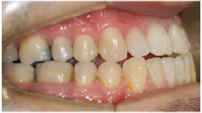
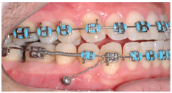
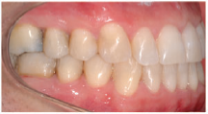
There is no evidence that in adults you shouldn’t open the bite by molars extrusion.
It is said that with TADs we can carry out tooth movements that would not be possible without them. So why is there not a single published case that shows such tooth movements. Here is a recent example class I molars to class I molars.
From JO Sept 2013

Slide 5
We advise against camouflage orthodontics but can we tell the difference
In these 8 photographs of patients only one shows a case with an ANB angle more htan 1 standard deviation from normal. Which one is it?

Slide 6
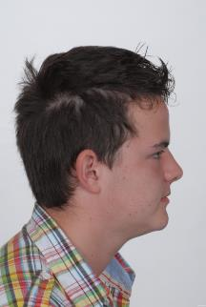
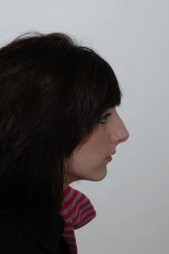
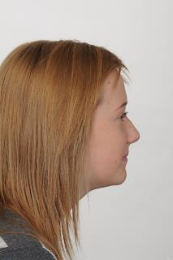
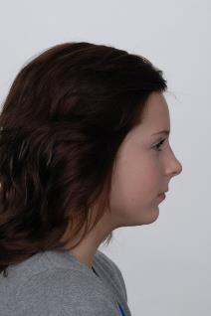
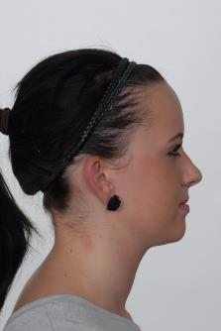
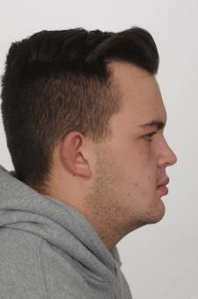
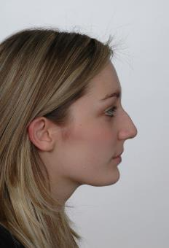
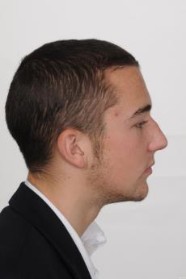

Slide 7
ANB=1
ANB = 4.5
ANB=4
ANB = 6
ANB=0
ANB= - 4
ANB=3.5
ANB =5.5

Slide 8
I showed pictures of patients with missing teeth
But can you tell which teeth are missing

Slide 9
You can’t tell which teeth are present

Slide 10
It was the upper 21/
Did you spot the displaced fraenum
In this lecture I would like to outline the things that I think are true
And illustrate it by showing you cases that I have never shown before in a paper called
The truth about orthodontics

Slide 11
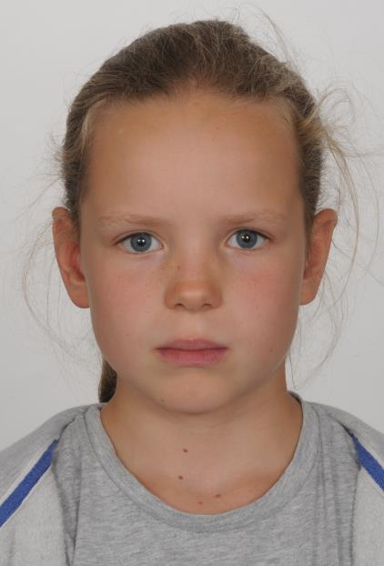
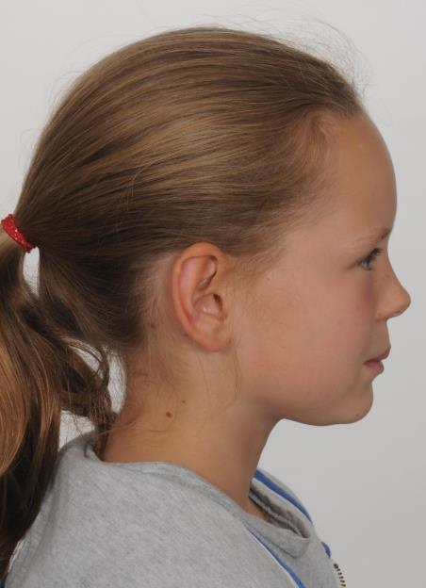

Slide 12
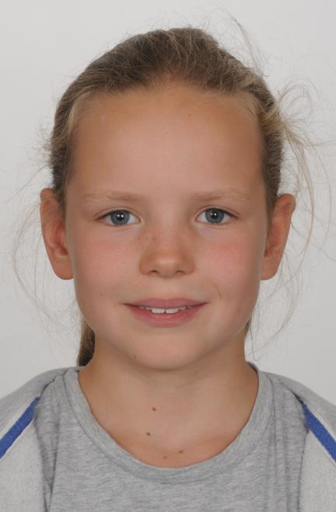
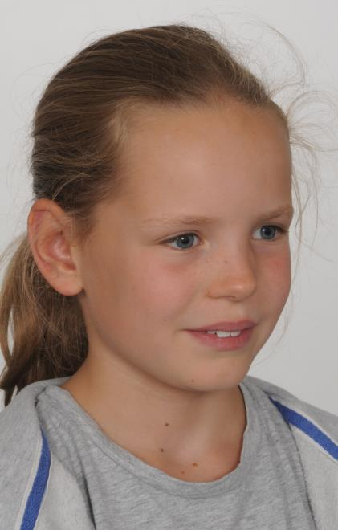

Slide 13
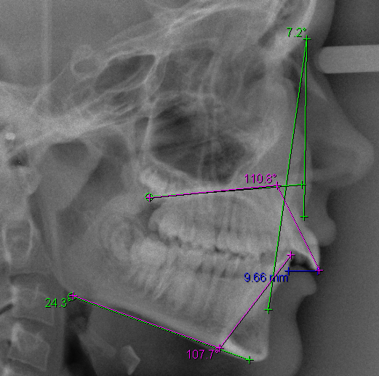

Slide 14
Patient has a class II div i maloclusion on a skeletal II base. 24⁰ MM angle and a 9.5 mm overjet. The arches are very well aligned and the molars are class II

Slide 15
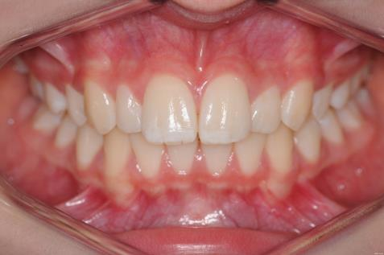
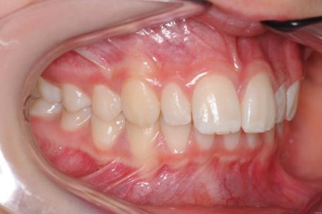
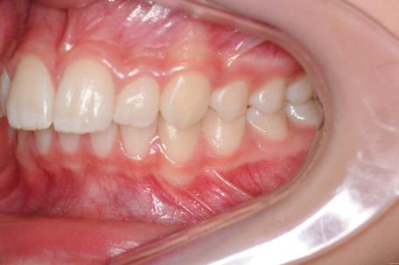

Slide 16
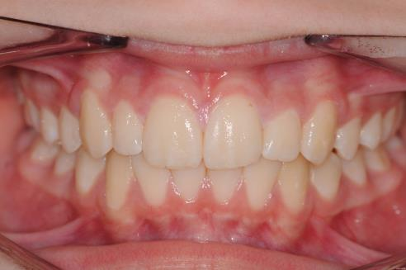
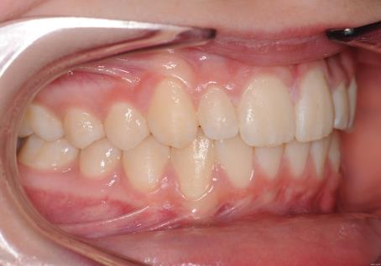
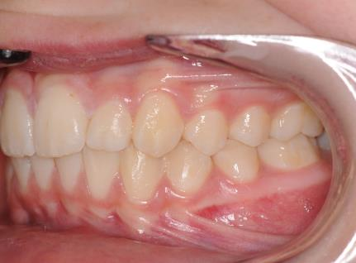

Slide 17
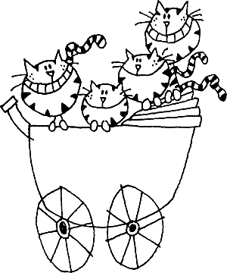
At the end of treatment the she has a normal occlusion. So we can say that We can move teeth

Slide 18
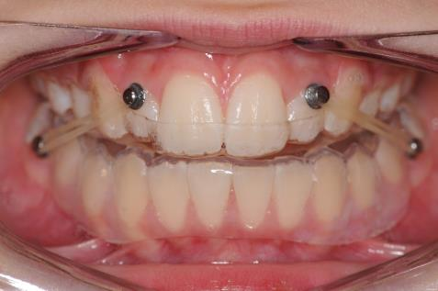
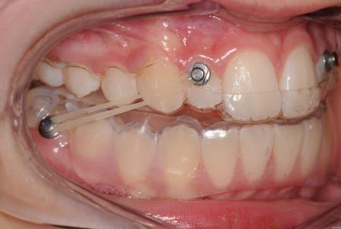
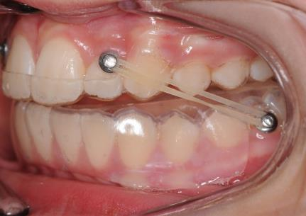

Slide 19
I Know that you knew that already but
This treatment was complete in just 3 months
It used the “Simple class II corrector” or if you like the button bead appliance

Slide 20
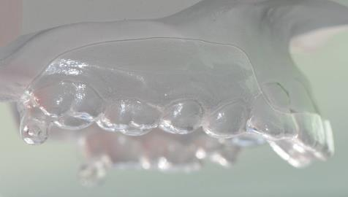
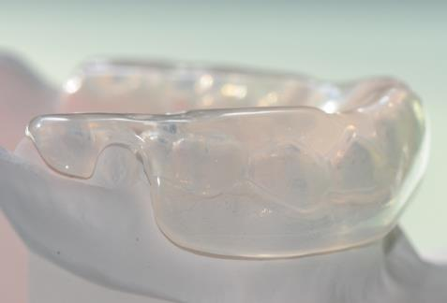

Slide 21
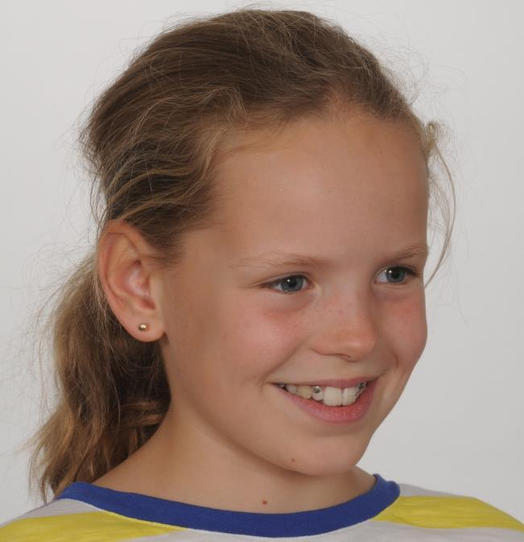

Slide 22
For details of the appliance go to the help-sheet on burtonortho.co.uk
Here are some more cases

Slide 23
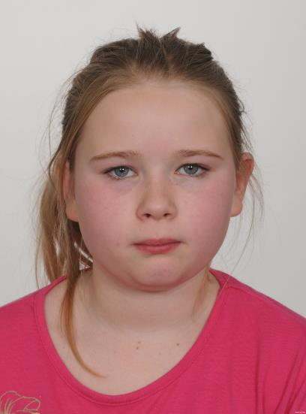

Slide 24
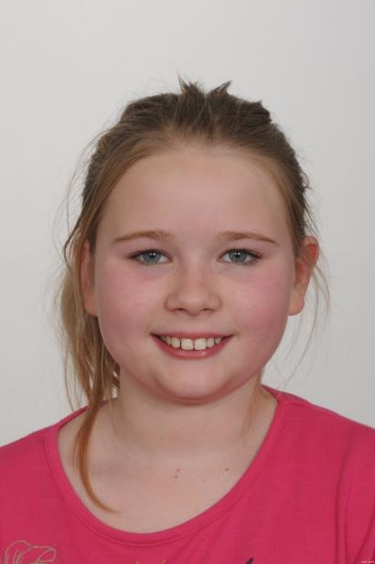
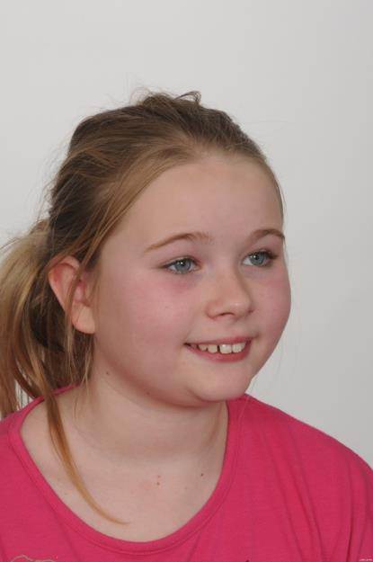

Slide 25
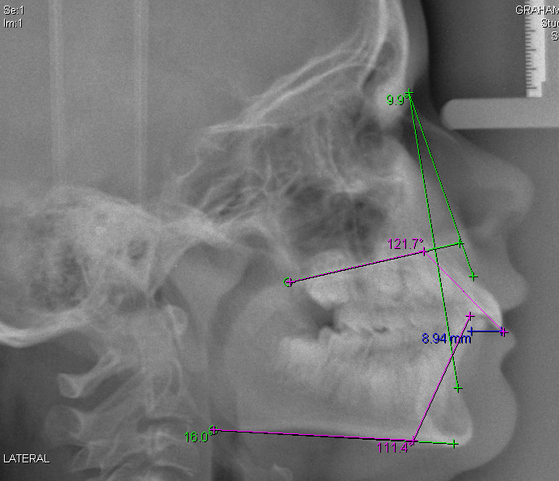

Slide 26
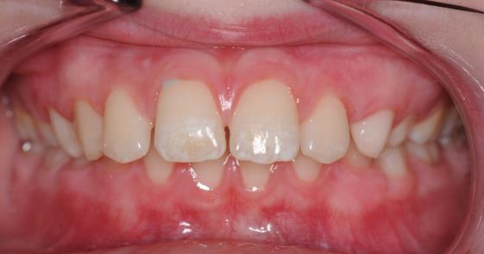
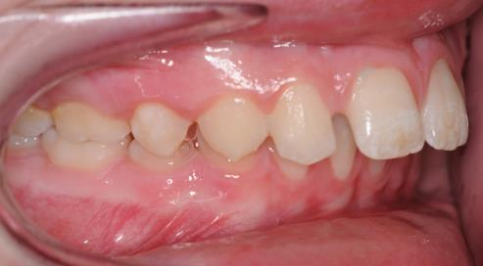
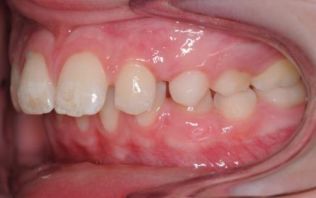

Slide 27
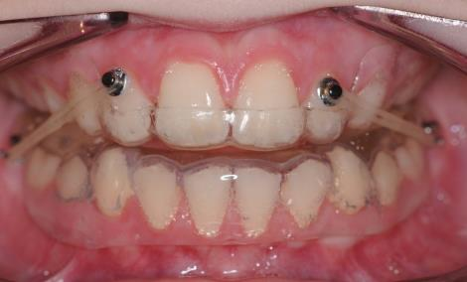
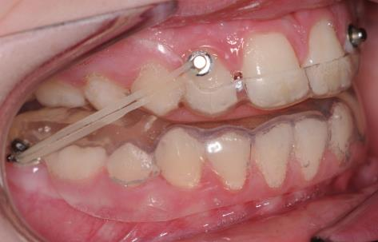
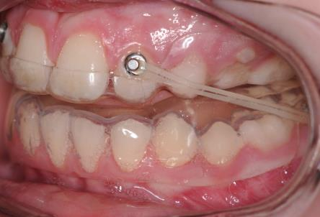

Slide 28
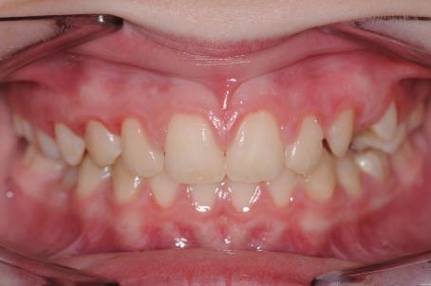
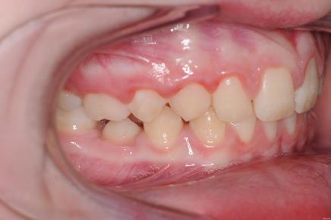
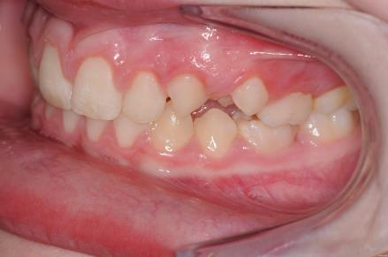

Slide 29
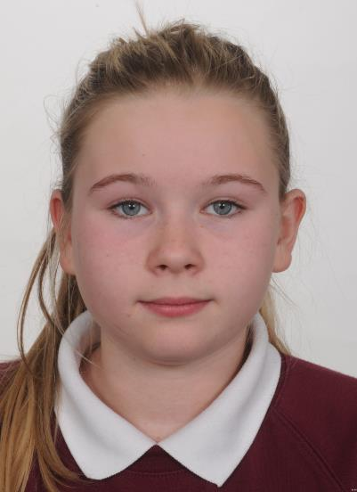
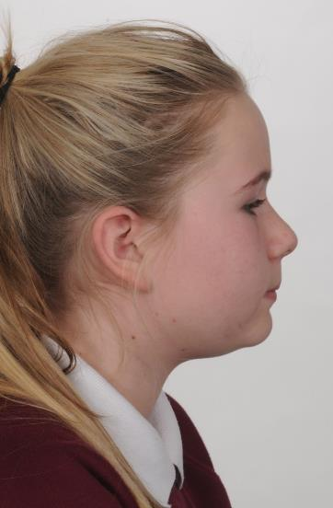

Slide 30
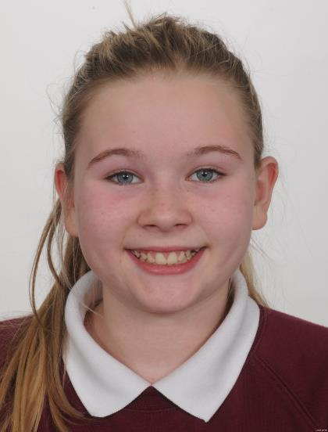
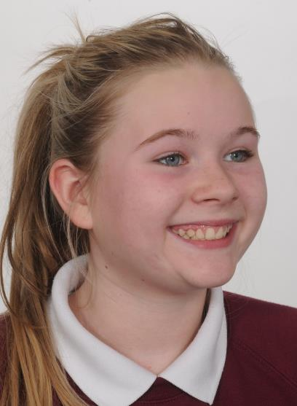

Slide 31
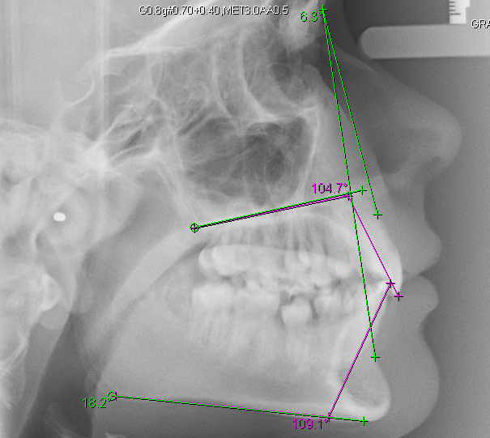

Slide 32
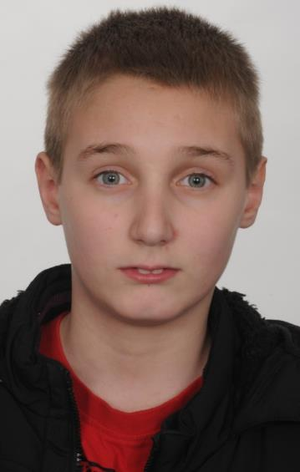
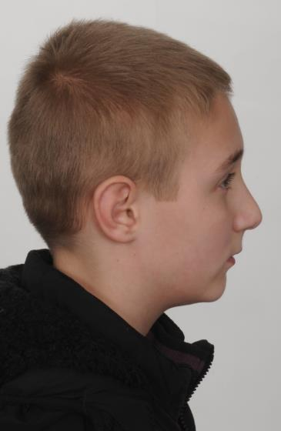

Slide 33
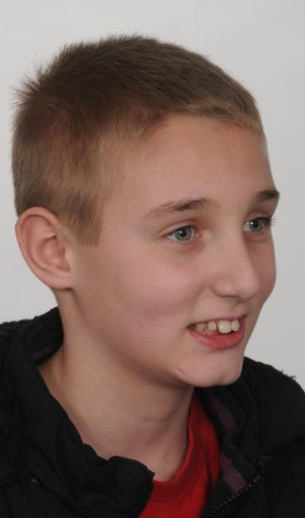

Slide 47
In this case the lateral incisors moved a little and I bonded upper 21/12 and re aligned them before continuing with the appliance
It is also true that the upper splint can break (I always make two) but apart from this the problems with this appliance are very few and it is much better tolerated than a twin block

Slide 64
Missing upper 2/2

Slide 67
Missing upper 52/25 lower 85/8

Slide 69
The same appliance can be used in reverse but in Class III you don’t NEED the BEAD

Slide 74
Why is this important?

Slide 75
(MYO) Functional appliance only work when the muscles are working. If the patient sleeps with the mouth open the appliance is not working.
In speech the mandible will not be postured forwards
Many patients remove twin-blocks for eating
Most patients remove the appliance for sports
So you have an appliance that doesn’t work when the patient is sleeping ,talking, eating and playing!

Slide 76
The button and bead can be worn all the time except cleaning the teeth

Slide 77
Even for sport

Slide 78
CASE WITH CEMENT ON 7S
I have been presenting cases with bite opening provided by cement on 7s for 15 years. In this case only flat archwires were used. It is simple quick and easy.

Slide 81
Flat archwires,cement on 7s and class II elastics

Slide 82
Remove the cement when the 6s contact

Slide 88
Don’t forget Fixed Bite planes are the way to open the bite where there are only a few contacting posterior teeth

Slide 89
UPPER Begg lower straight-wire
This variation of the Begg technique is my own but the first case was treated by my colleague Peter Dale

Slide 94
6⁰

Slide 96
Phase A Alignment with 0.014 niti

Slide 97
Phase B Bite correction tip back the molars with anchor bends and tip back 543 with uprighting springs

Slide 98
Cement on7s & LBR

Slide 99
Phase C Cuspation remove the cement and use elastics to pull the teeth into occlusion

Slide 100
Phase D Detailing with torquing auxiliaries and uprighting springs (usually not at the same time)

Slide 101
Nance Button

Slide 104
Debond

Slide 105
3⁰

Slide 107
6
Note the lower incisors are not proclined
6⁰
3⁰

Slide 108
SEVERE ii DIV ii SOME PROCLINATION OF THE LOWER INCISORS
In some cases you want to procline the lower incisors

Slide 111
Phase A Alignment

Slide 113
Phase B + EOT high pull night only for 6 weeks

Slide 117
Once you can do this you will find it has many uses. Other uses upper Begg lower SWA
Un-erupted canines
Class II div i
Failed or incomplete functional treatment
Buccal canines. (crowding)
Re-treatment

Slide 118
Unerupted canines

Slide 120
Class II div i

Slide 124
upper arch crowding

Slide 127
Failed Functional

Slide 129
JH someone has been here before

Slide 133
Case LP
Problem List
Class II div i
Un-erupted canines
Missing lower right 6
Lower centreline shift

Slide 136
Note lower centreline to right

Slide 140
Opening canine spaces. Modified Pedro mechanics in the lower

Slide 141
Elastic chain buccal and palatal to lower 7 to tip it forwards

Slide 143
Second molars tipped forwards

Slide 144
Picking up lower 7

Slide 145
Phase B Bite correction

Slide 146
Phase C Cuspation

Slide 149
 | START | FINISH
SNA | 86 | 84
SNB | 78 | 79
ANB | 8 | 5
UI | 106 | 100
LI | 88 | 89
OJ | 6.5 | 2.5
OB | 7.5 | 2.5
MM | 28 | 32
LiAPo | -2mm | -2mm

Slide 157
Can you see why upper Begg lower straight-wire works so well?

Slide 158
People don’t like having teeth out even deciduous teeth
Or TADs

Slide 159
Modified Pedro mechanics
Used for space closure 0.019 x 0.025 steel wire bend down hard just distal to the tooth in front of the gap and use class II elastics to hold this tooth in position.
Use elastics on buccal and lingual to tip the tooth forwards
Then tie the tooth to the rest of the arch. Upright with NiTi and short class II

Slide 160
Pedro mechanics

Slide 163
Yes of course
Severe cases require surgery but I think we have gone too far down the line of saying orthodontics can do little more than align the teeth
I think there is even a case for moving the lateral into the space of a central. Certainly it is better than rushing to extract a sound premolar in juveniles

Slide 164
Last case

Slide 167
Can your surgical colleagues take impacted third molars and make them erupt?
Can your restorative colleagues take grossly carious teeth and turn them into perfectly sound teeth?
Can your paediatric colleagues take cases with one functioning molar per quadrant and make it two

Slide 168
YOU CAN- and you can
Reduce BIG overjets
Open deep overbites
Correct class II molars
Close space where teeth are missing
-Be proud of orthodontics

Slide 169
And if you don’t do all of these things

Slide 170
Try it and you will find you can

